Slide 1
INTRODUCING the icons

Slide 2
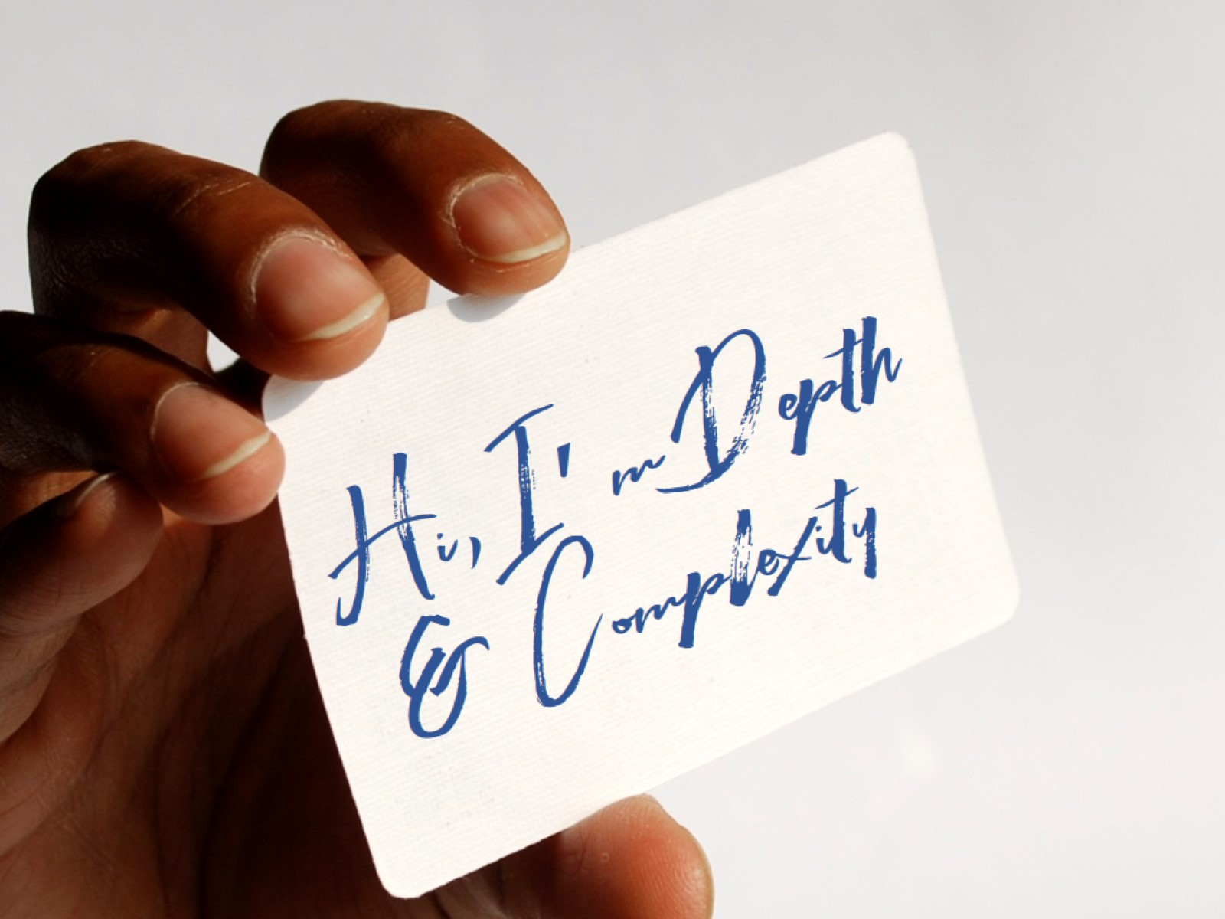
Hi, I’m Depth & Complexity

Slide 4
SYMBOLS:

Slide 5
Notes:
Symbols are all around us. When a symbol becomes so commonly known that almost everybody knows what it stands for, we call it an icon. How many of these icons do you recognize?
Notice how icons actually convey a lot of information – they tell you what to do and what not to do. They convey and elicit emotion. They are powerful.
Have them turn to a partner and come up with three more icons not displayed. Now, pick the most emotionally powerful of the three. If you think yours is at least a four on a ten point scale of emotional power, have one partner stand up. Okay, at least a seven. Call on those. Have others stand if they agree. Allow others who didn’t stand to re-evaluate.
Discuss what this did – see the high level going on here – have to remove stigma of pride in response.
Brainstorm Common Everyday Icons - use website iconfinder.com

Slide 7
We’re going to use a particular set of 11 symbols to help us engage with our learning.

Slide 8
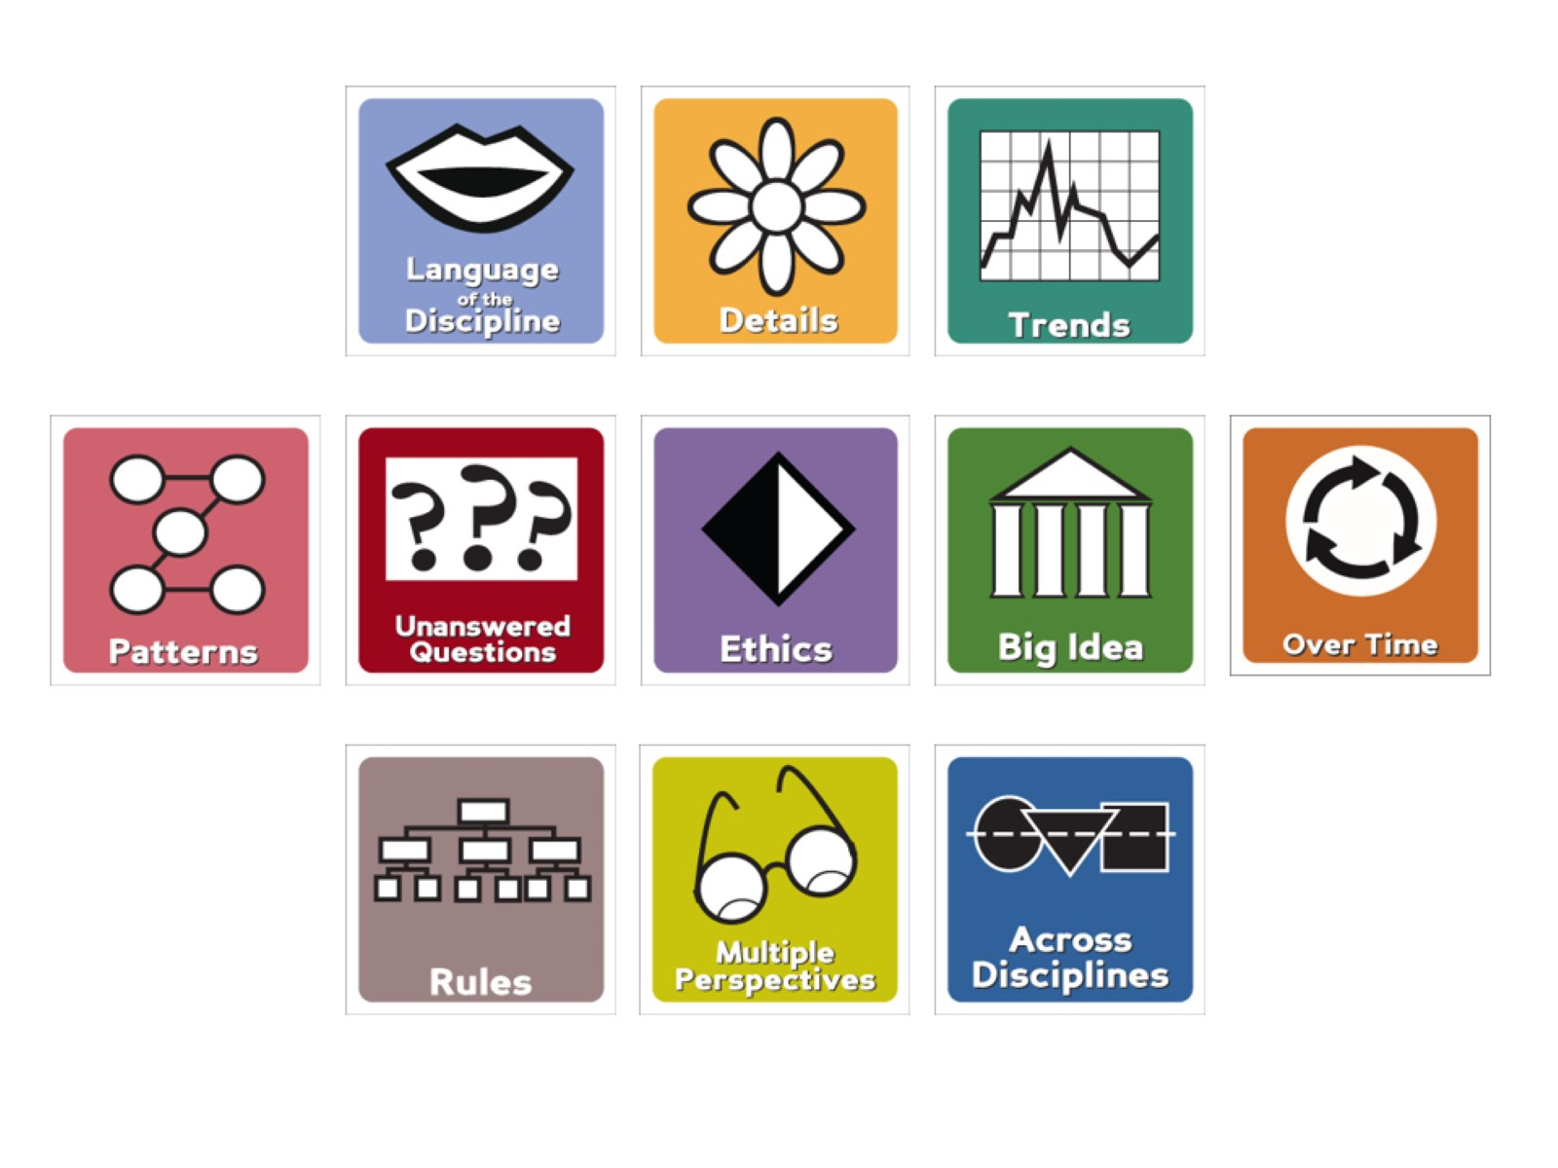

Slide 9
And they will…

