Slide 3
1. Understand why & how you will use it in your class

Slide 4
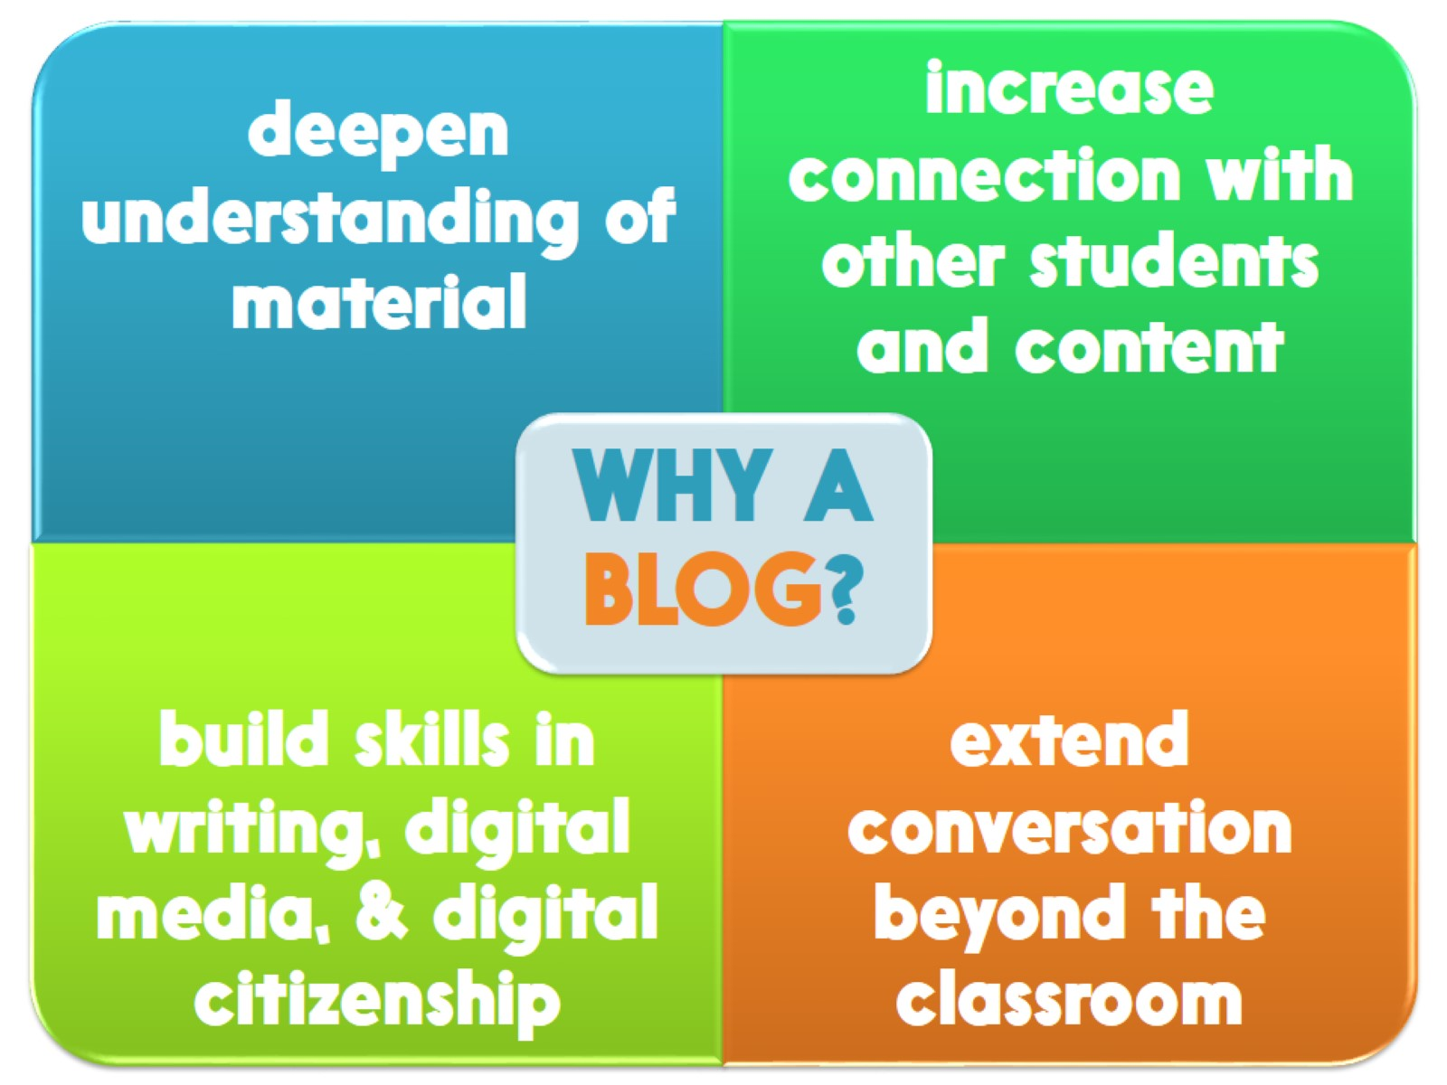

Slide 5
WHAT TO DO WITH THEM

Slide 6
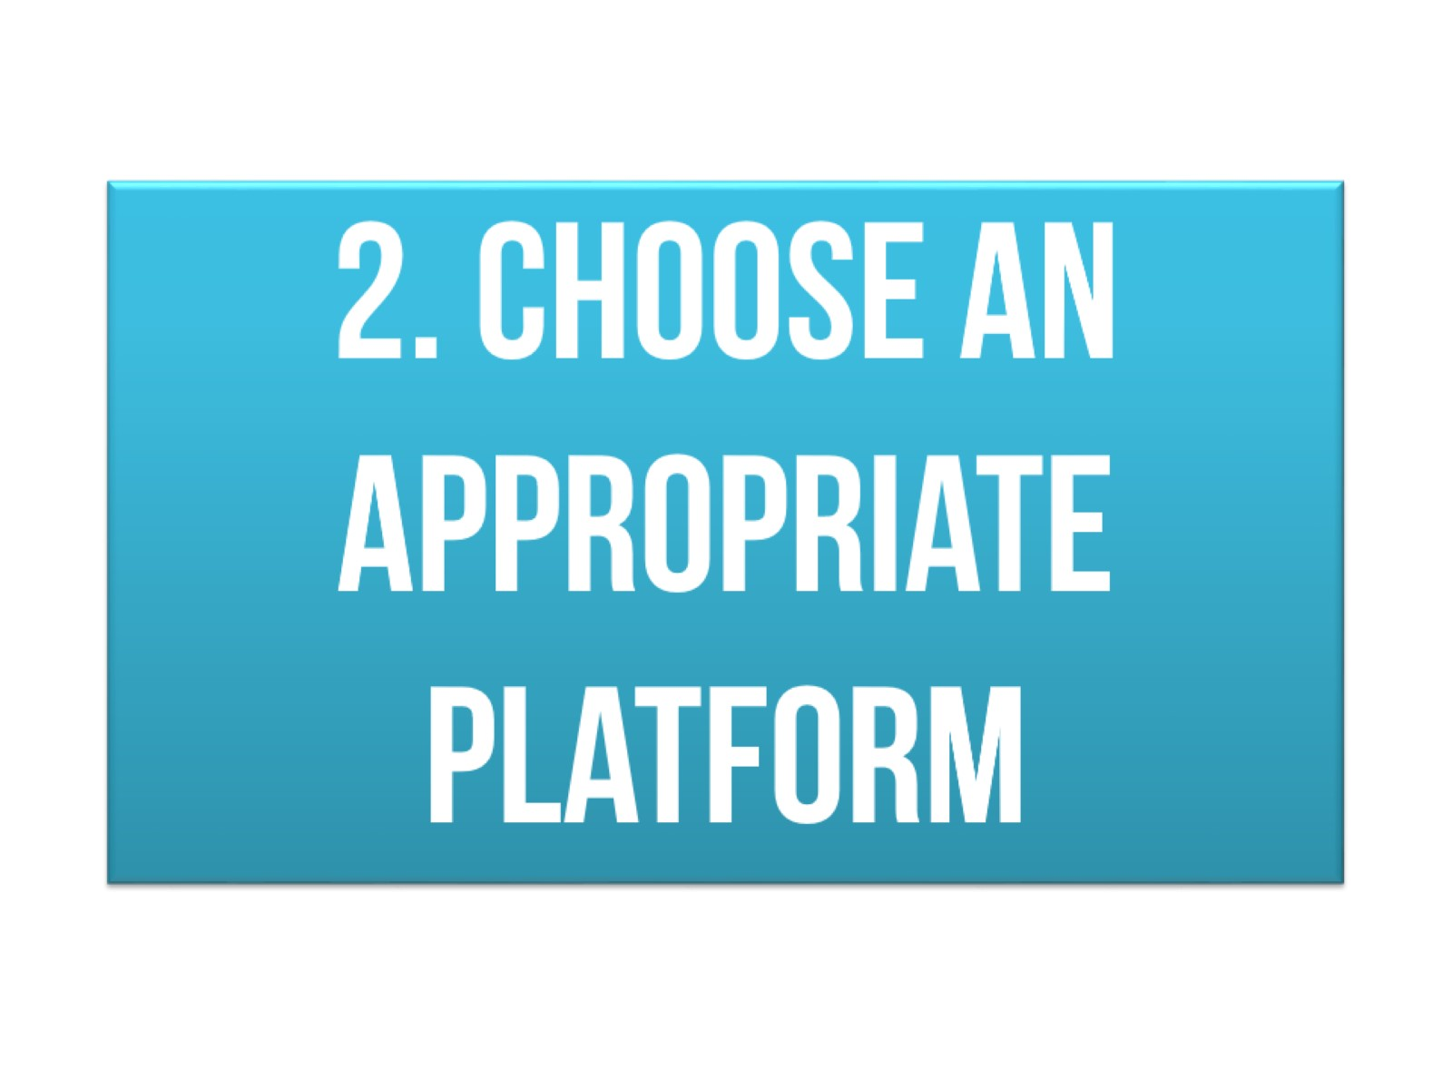
2. Choose an appropriate platform

Slide 7
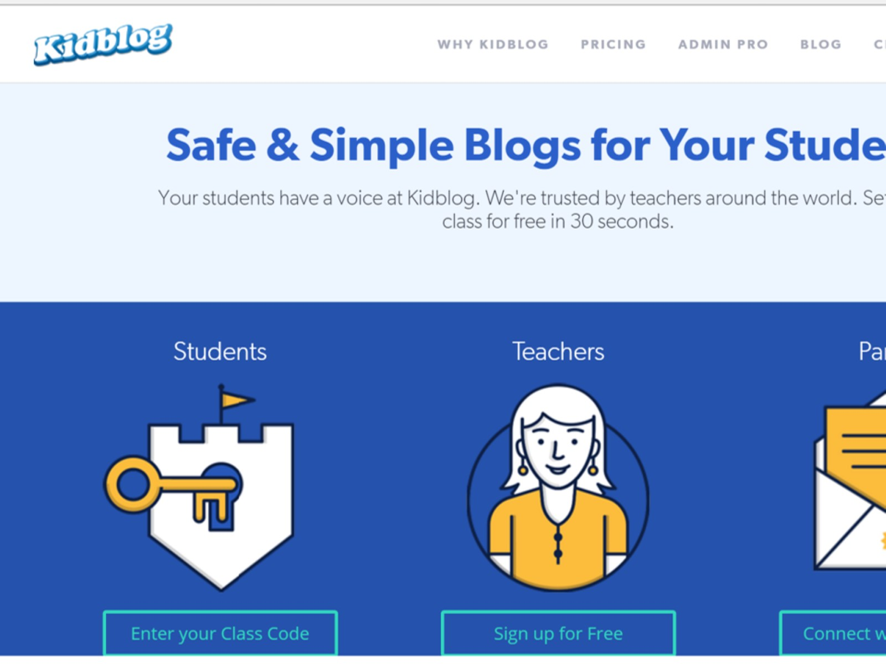

Slide 9
3. Understand the features you & students will be using

Slide 10
USE THE TUTORIALS

Slide 11
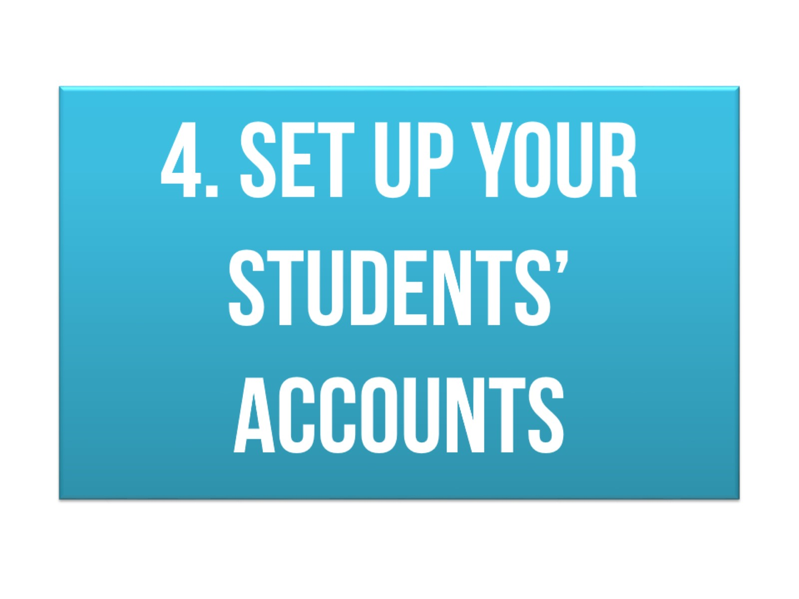
4. Set up your students’ accounts

Slide 15
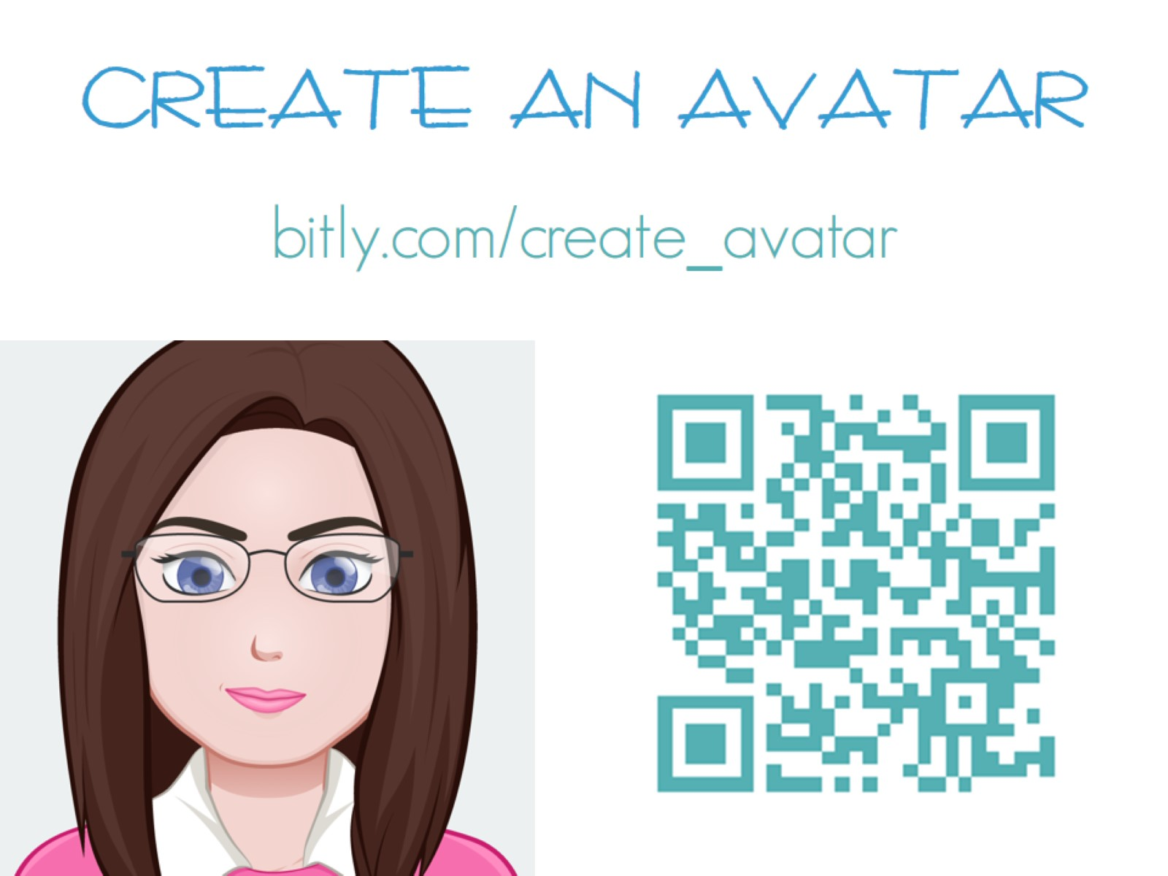

Slide 16
5. Know what to do when students forget login/pw

Slide 17
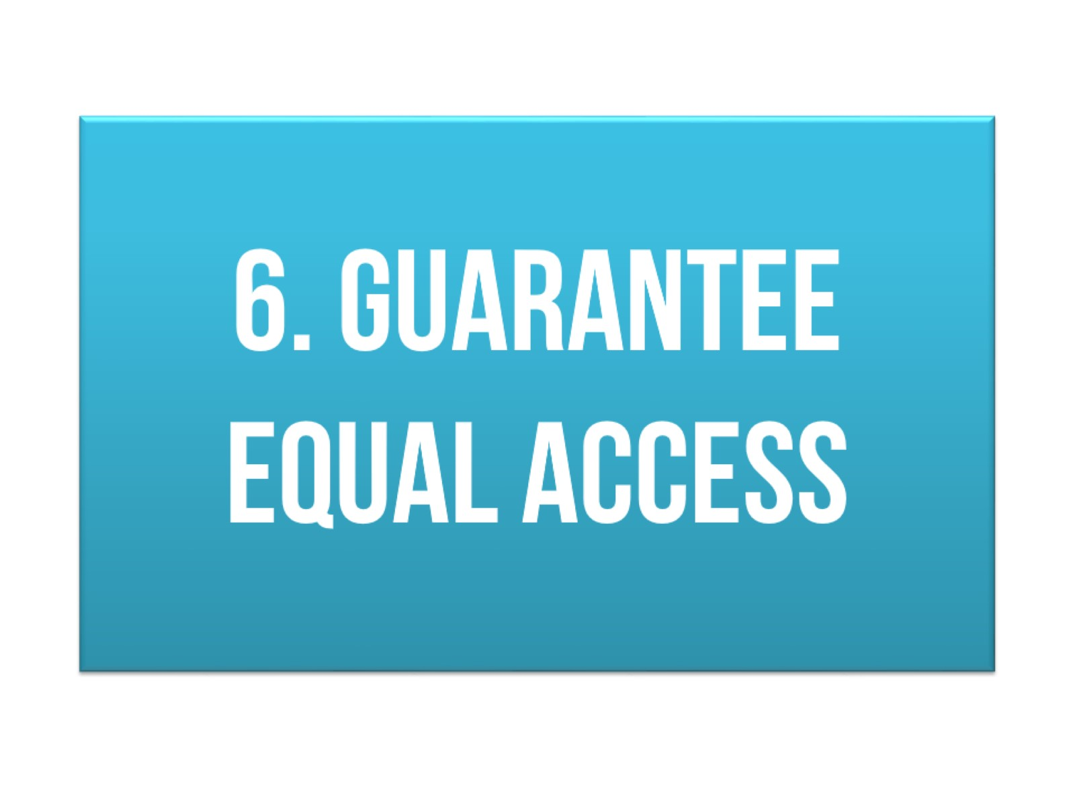
6. Guarantee equal access

Slide 18
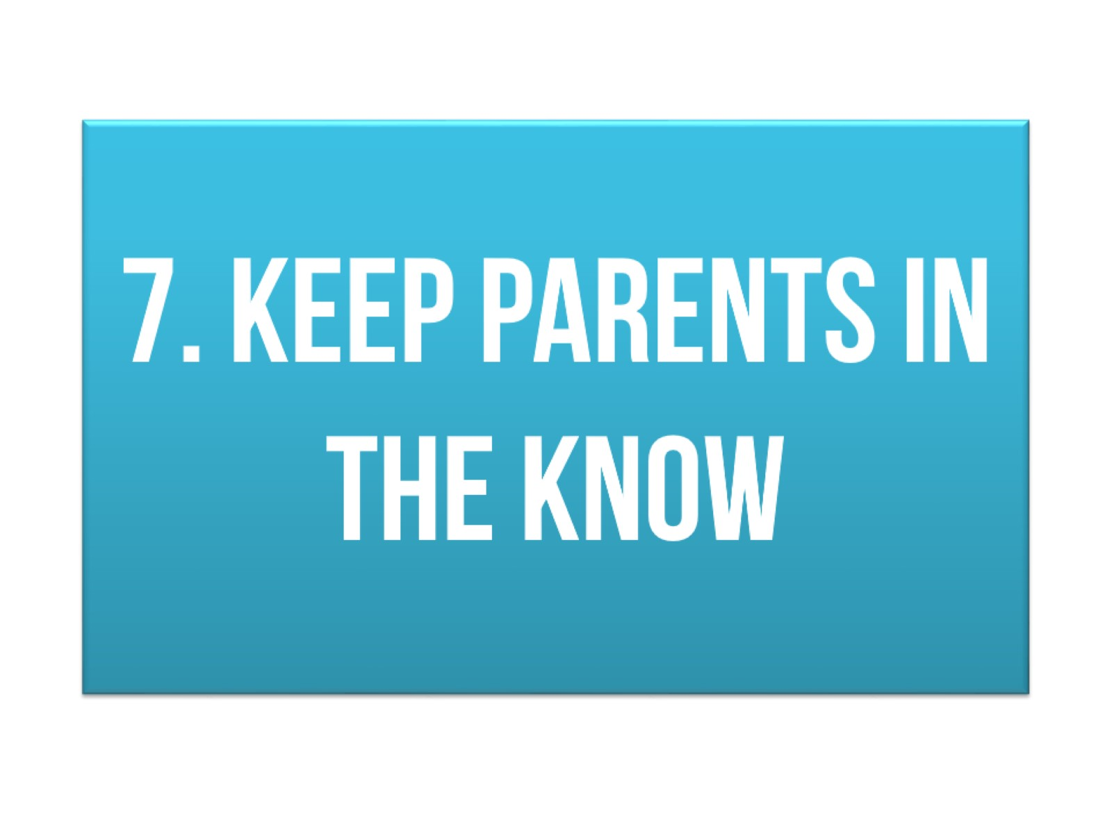
7. Keep parents in the know

Slide 19
8. Set the boundaries & expectations

Slide 20
HOW THE INTERNET IS LIKE THE MALL

Slide 21
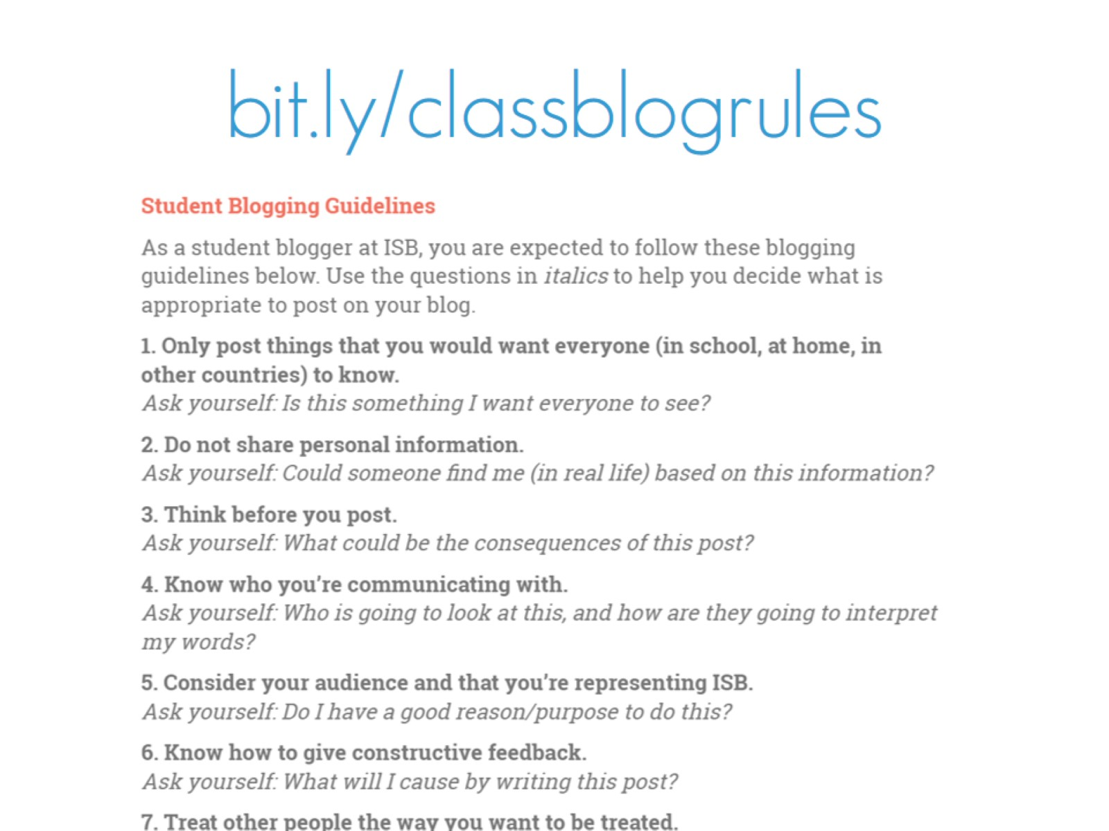
bit.ly/classblogrules

Slide 22
9. Display the code of ethics

Slide 23
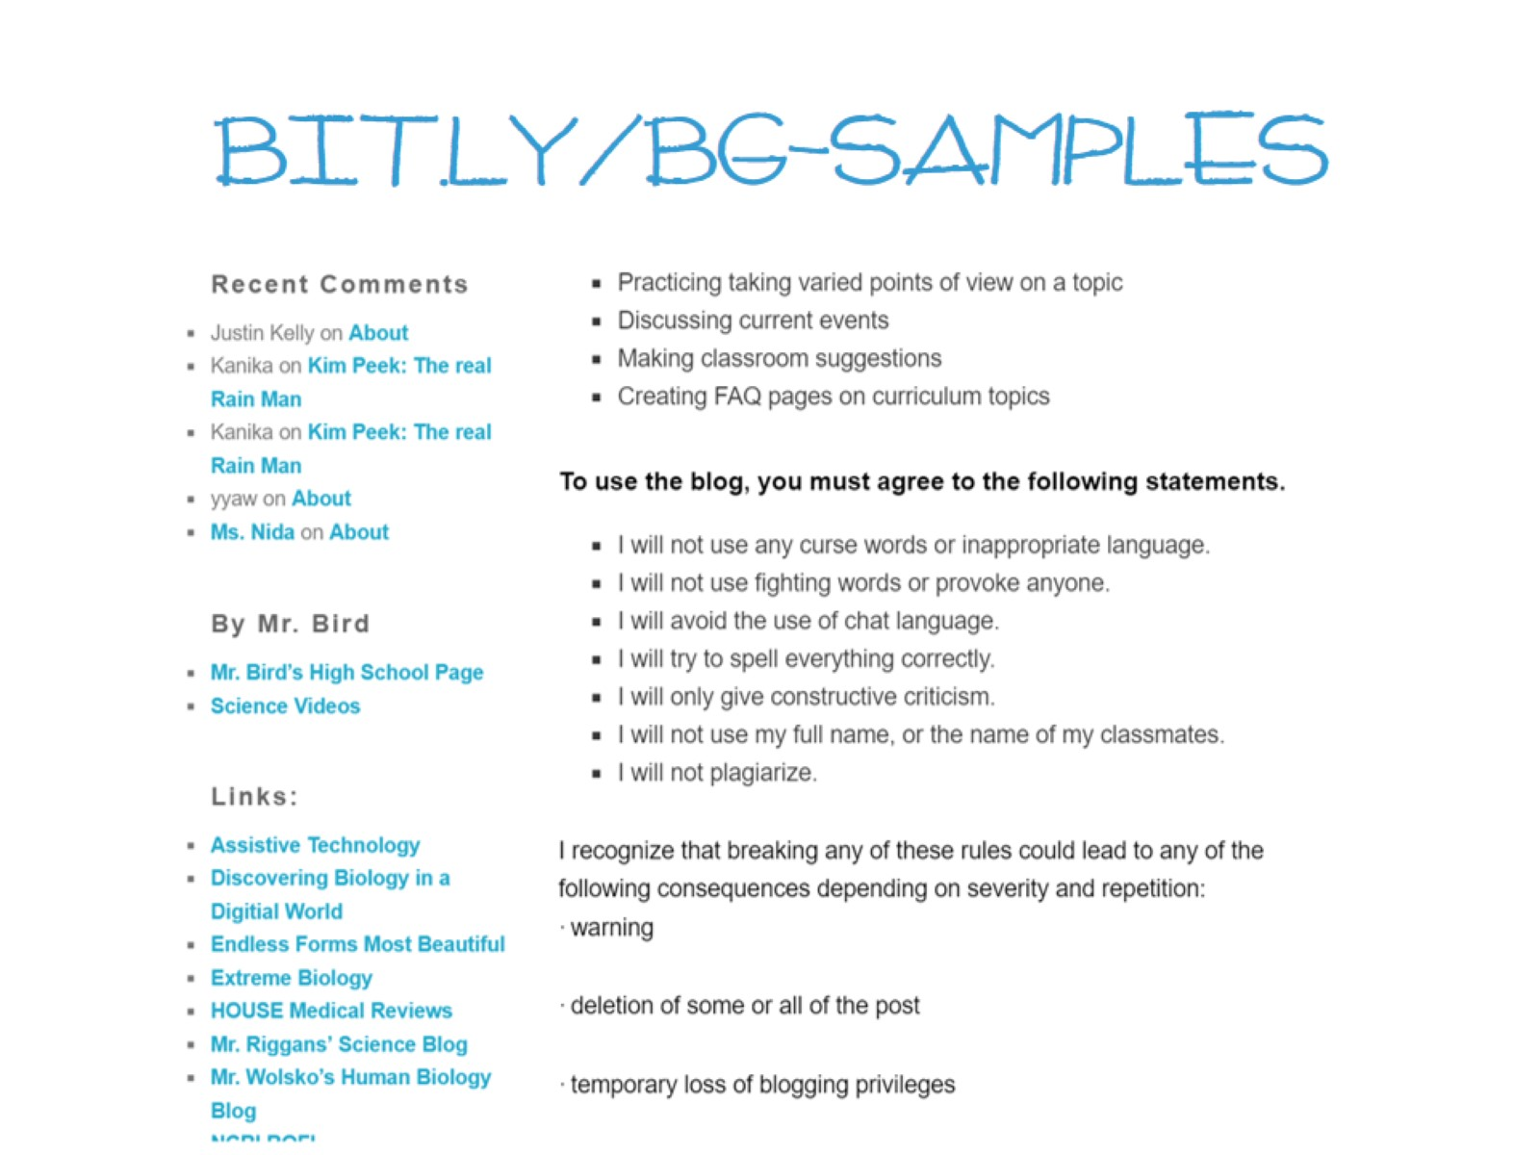
bit.ly/bg-samples

Slide 24
Go slowly, step by step.

Slide 25
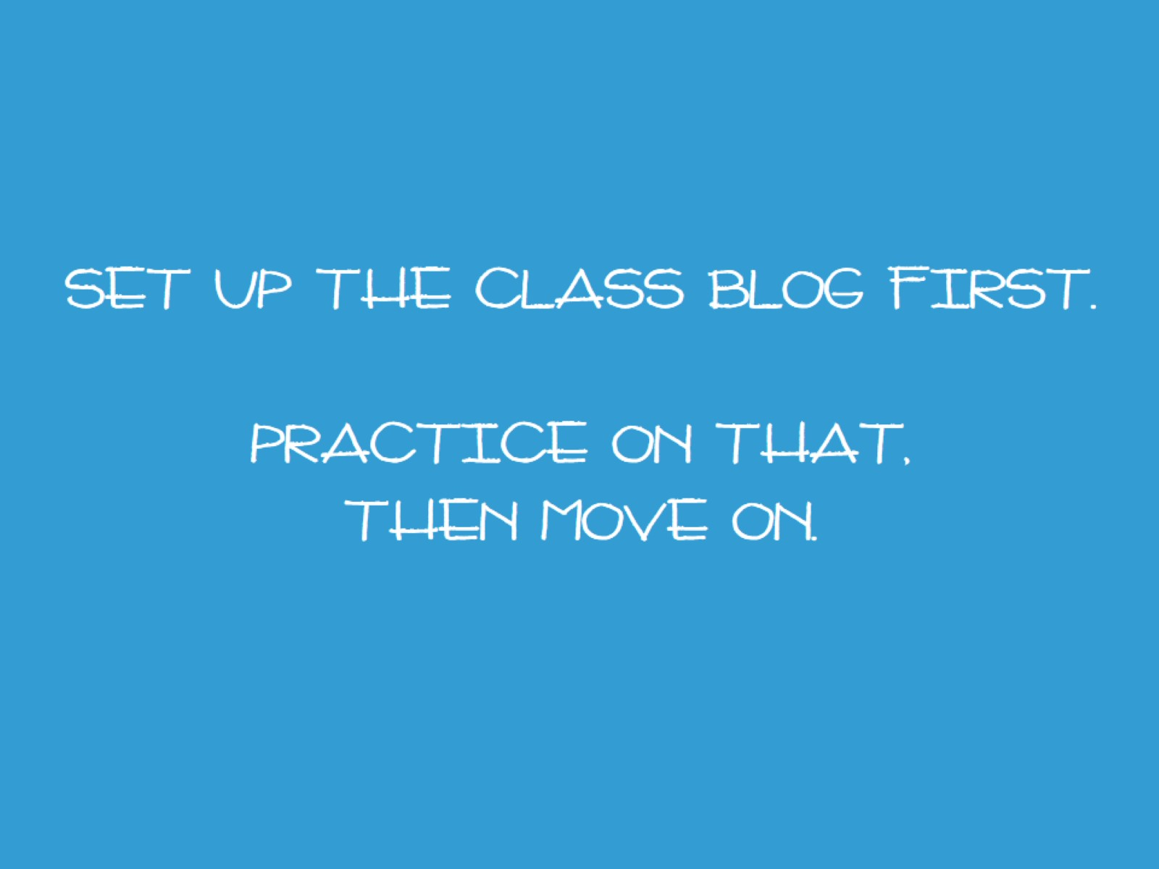
Set up the class blog first. Practice on that, then move on.

Slide 26
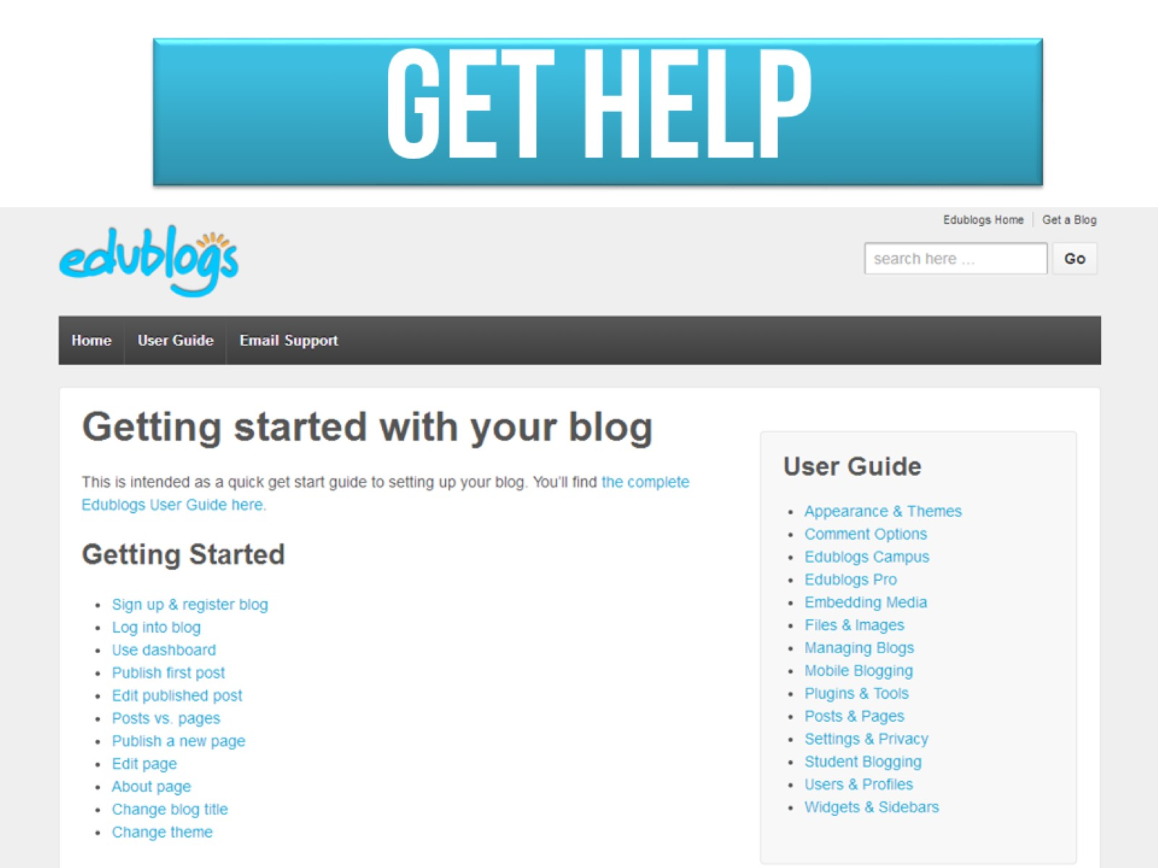

Slide 27
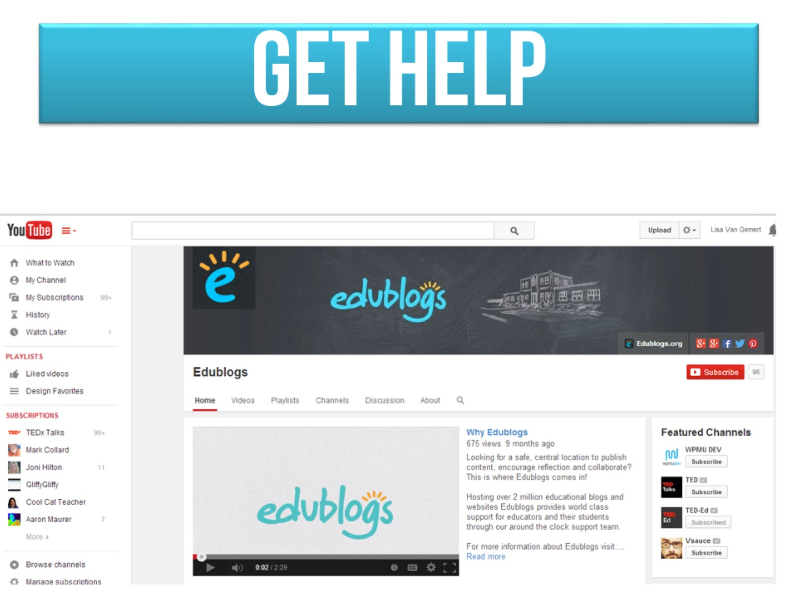
Get help

Slide 28
Our blogs

Slide 29
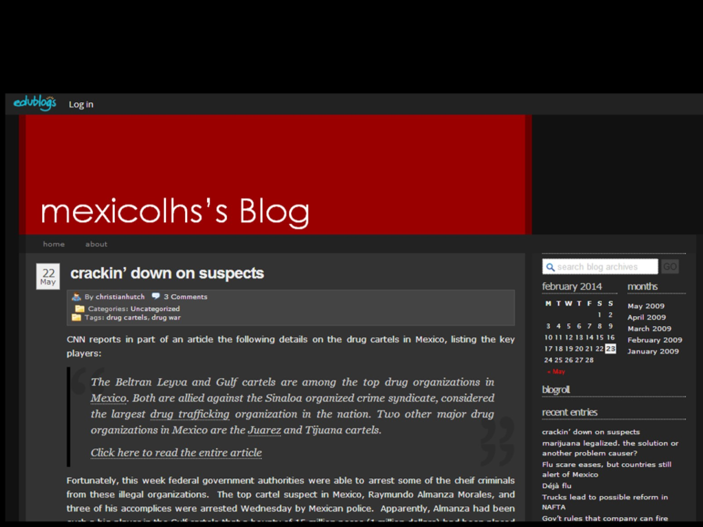

Slide 32
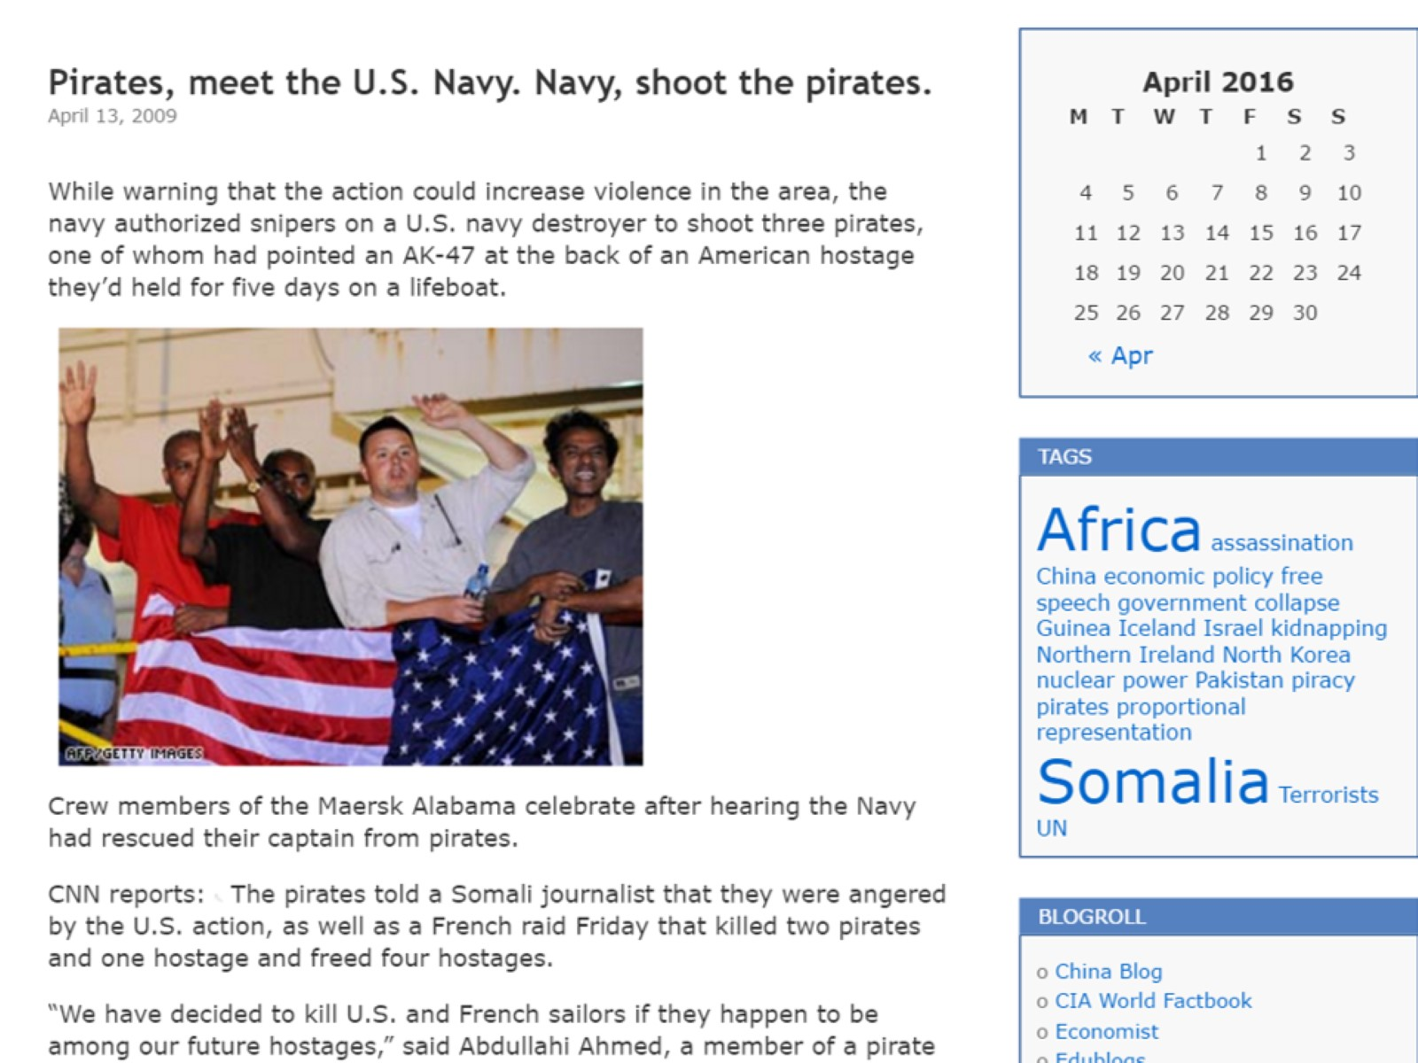

Slide 33
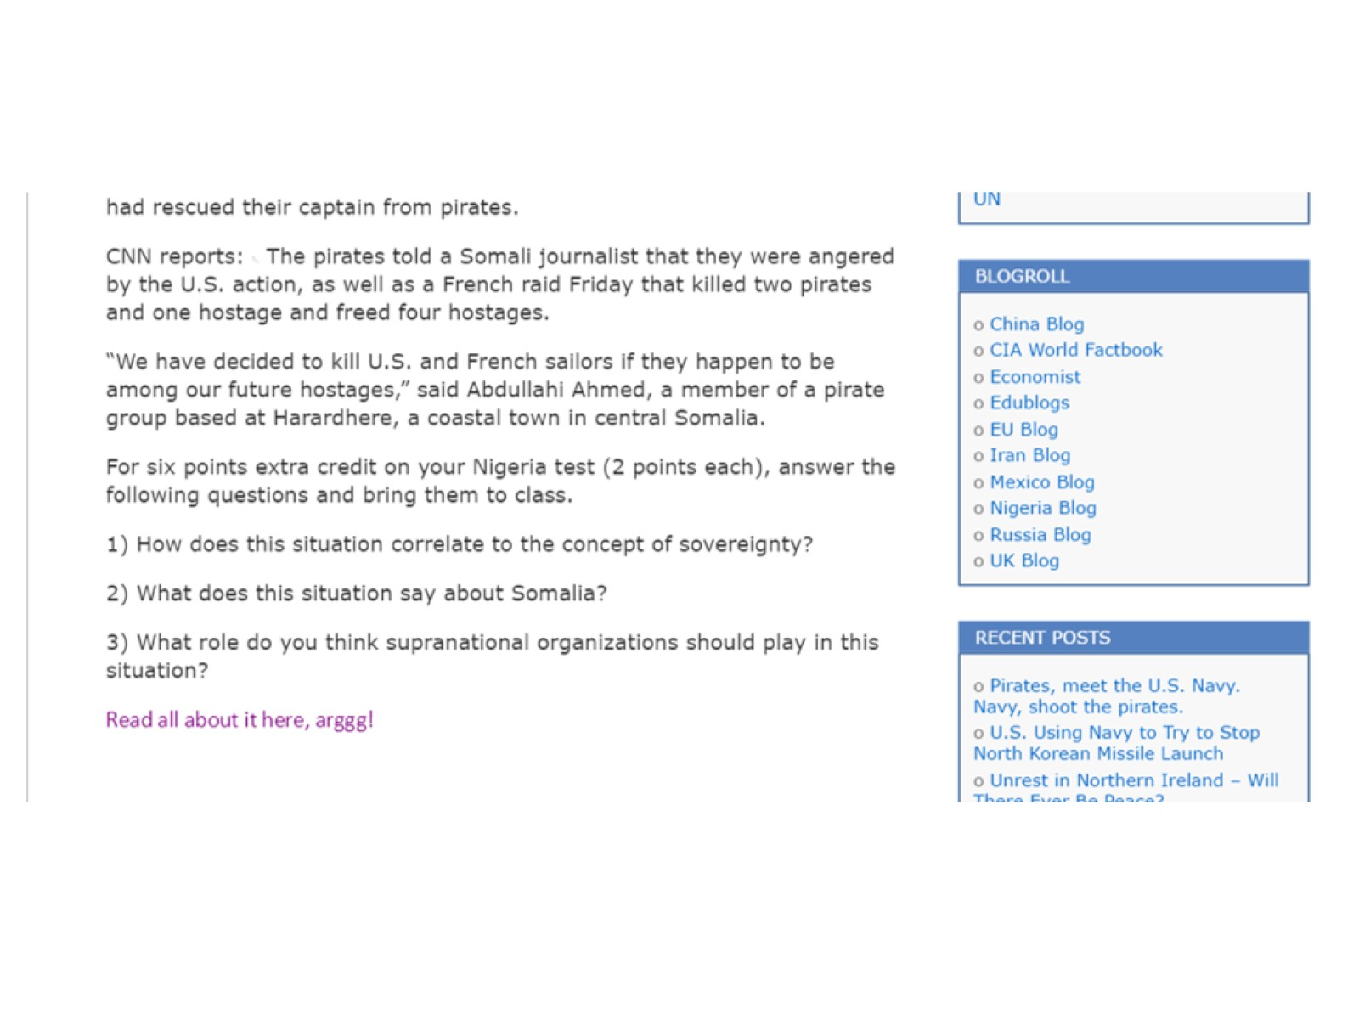

Slide 35
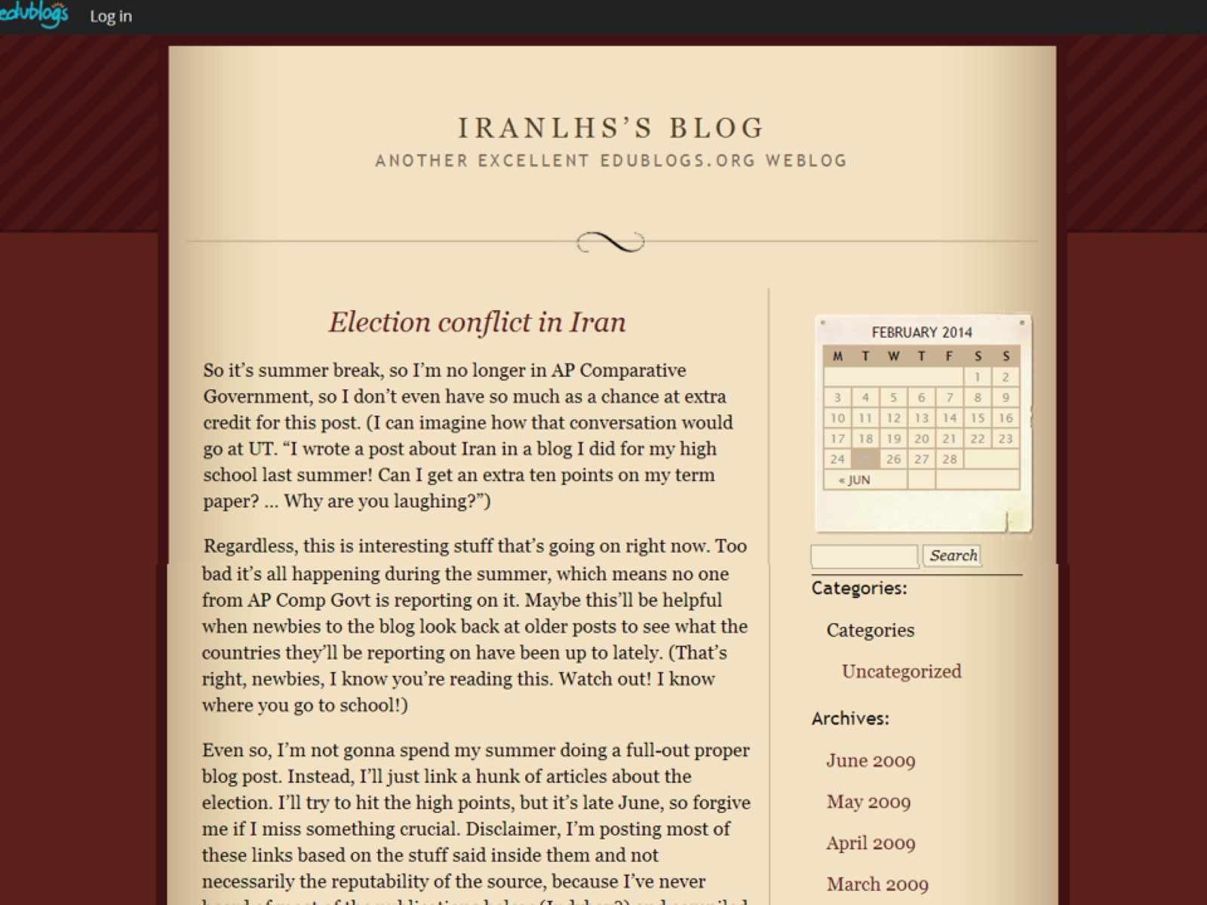

Slide 36
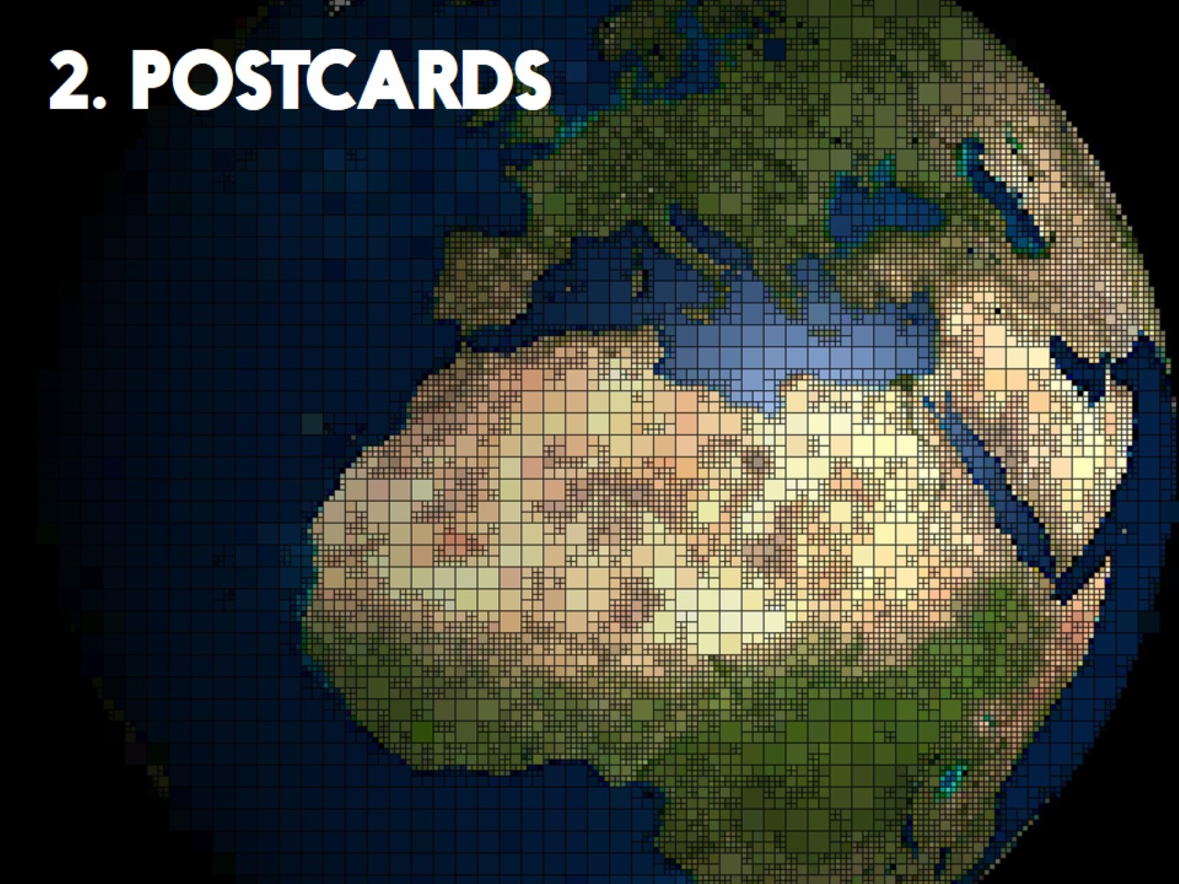

Slide 37
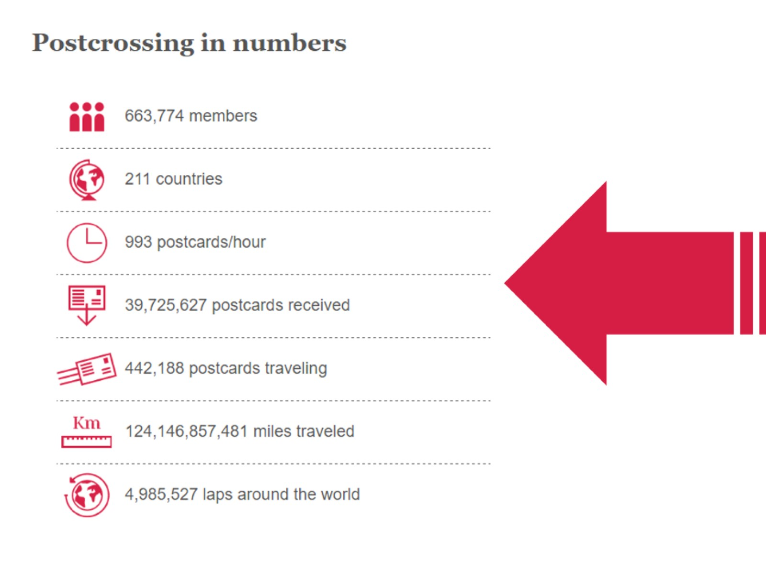

Slide 38
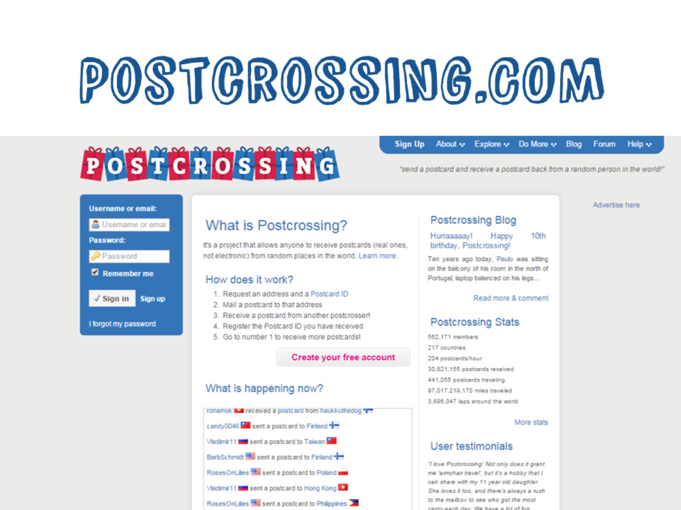
Postcrossing.COM

Slide 39
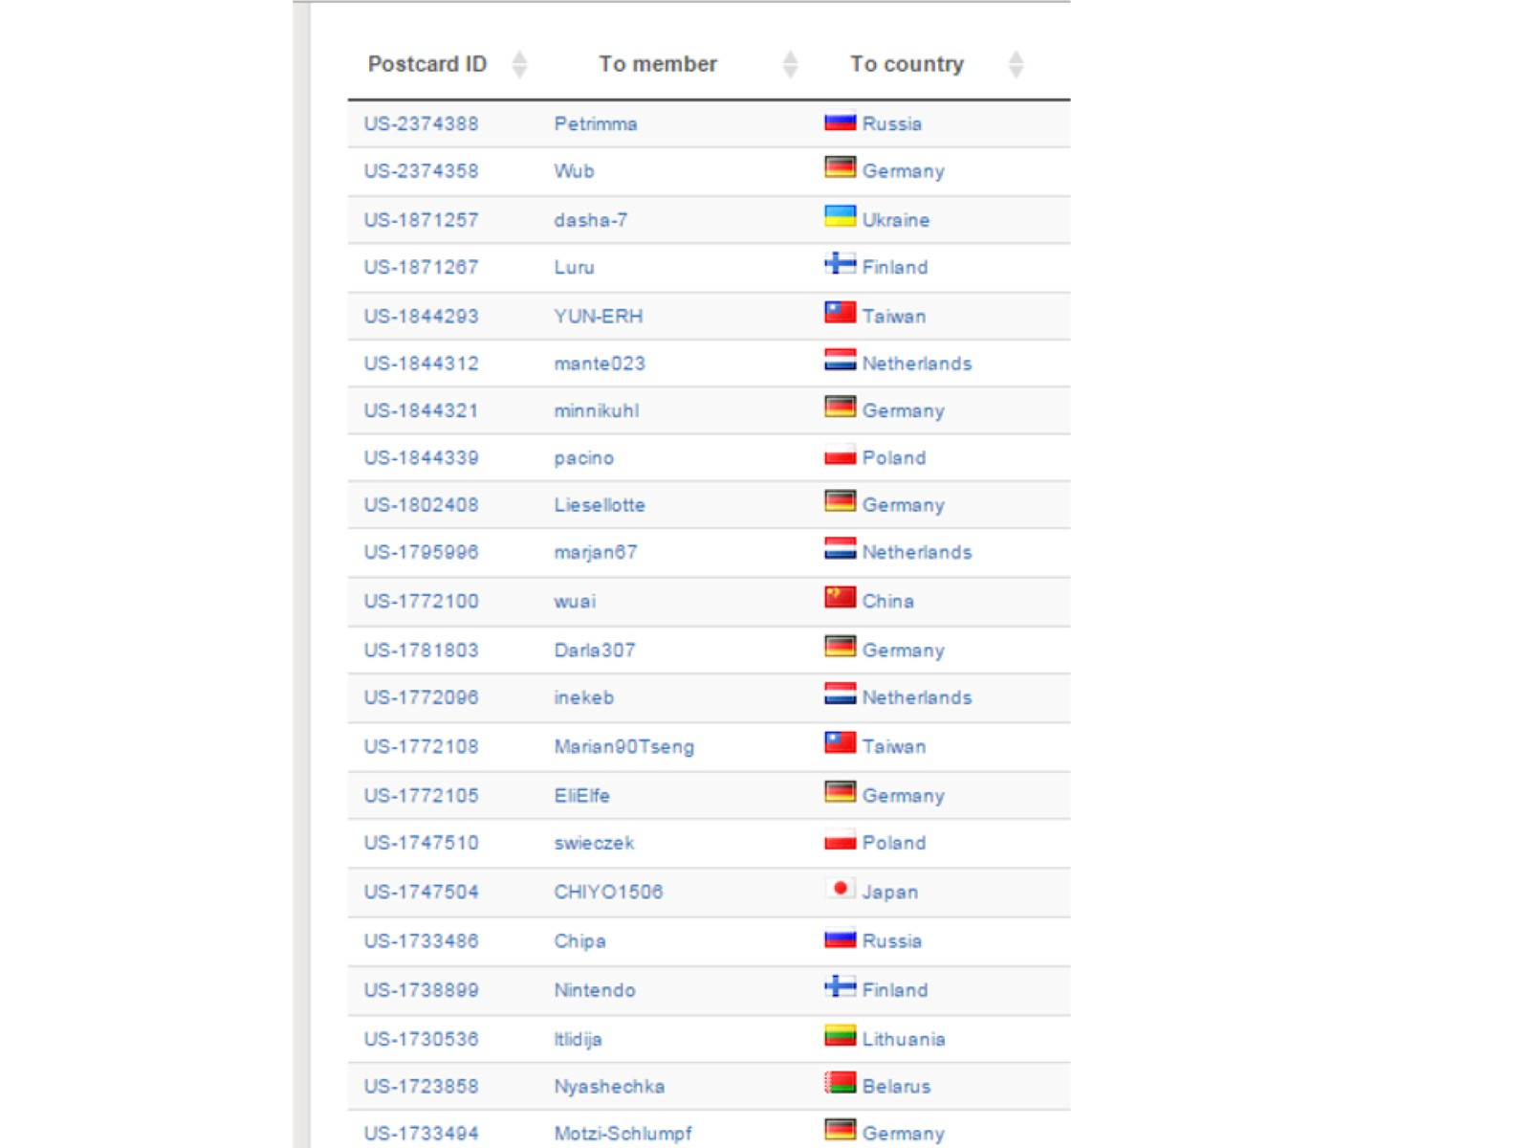

Slide 40
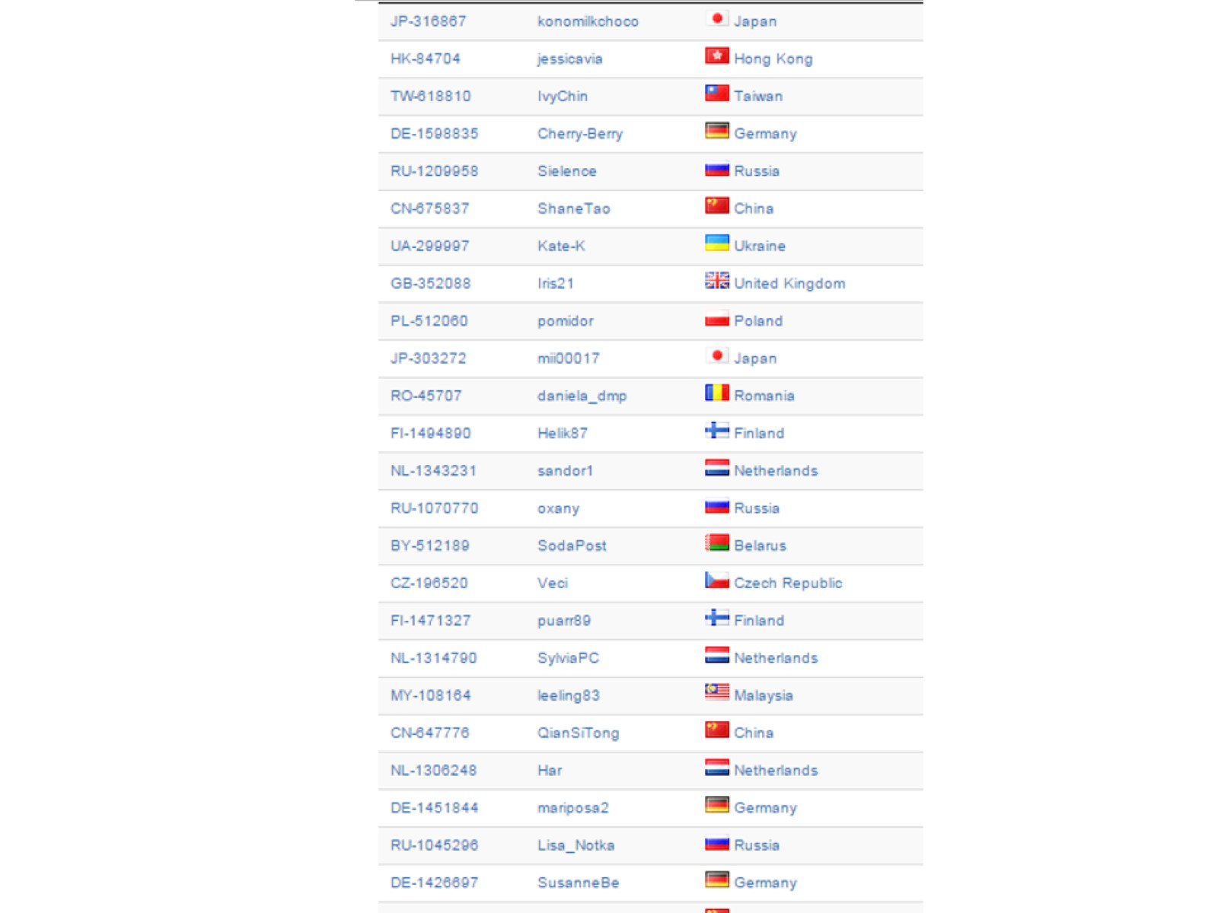

Slide 41
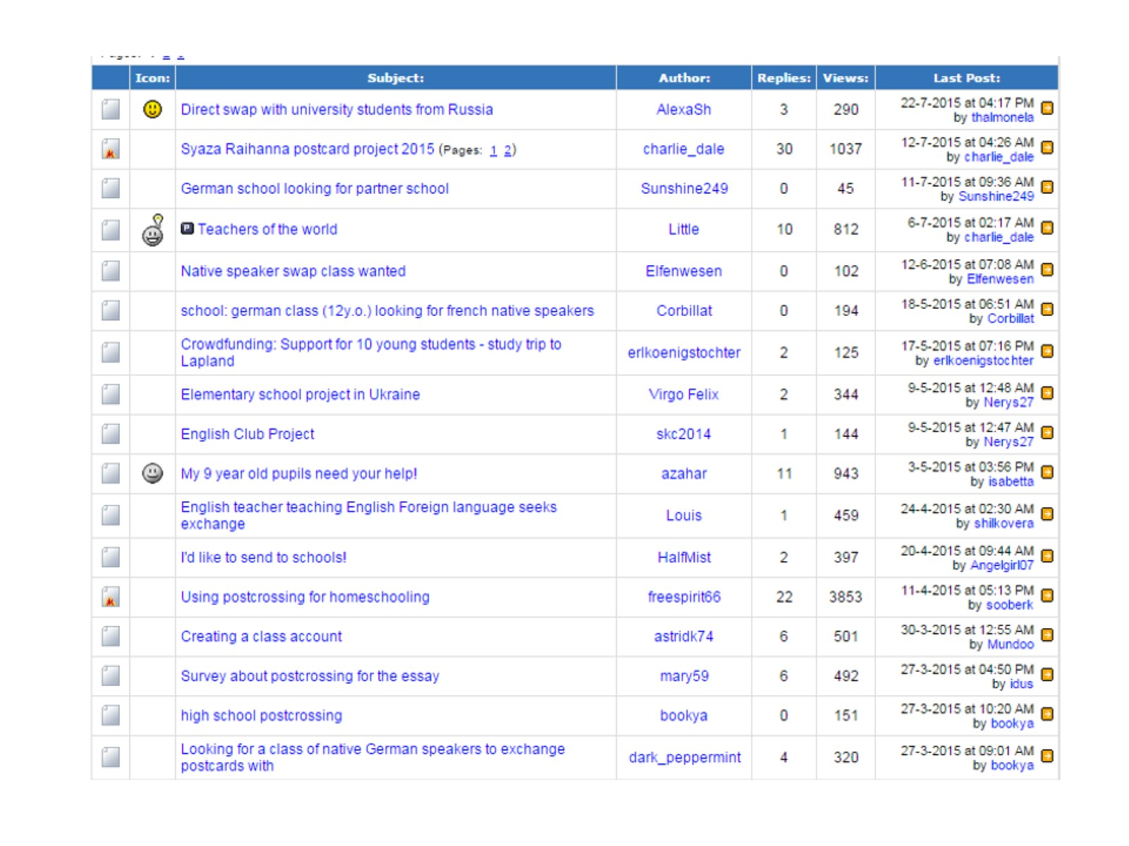

Slide 42
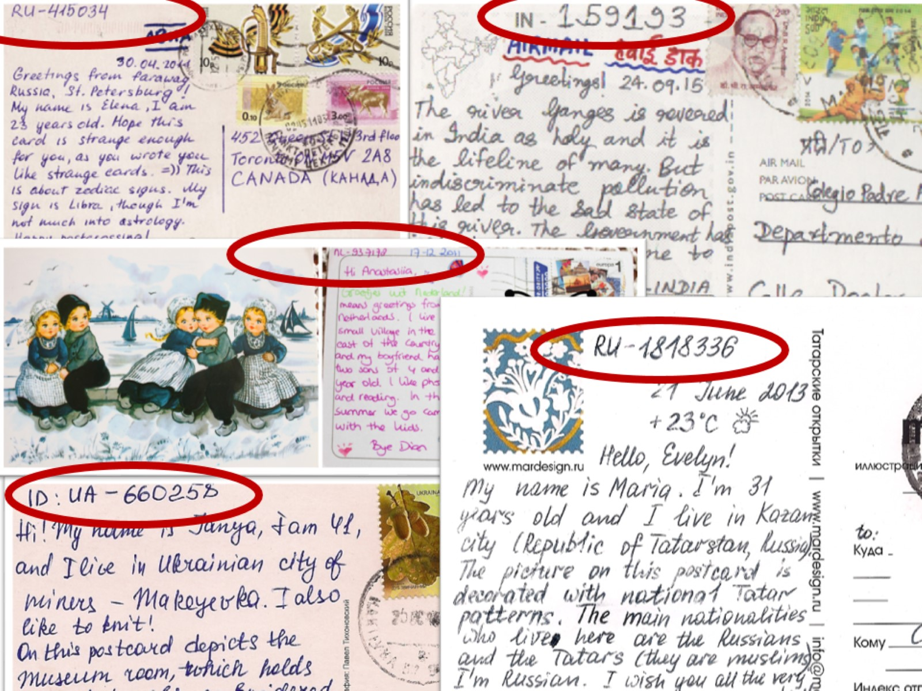

Slide 43
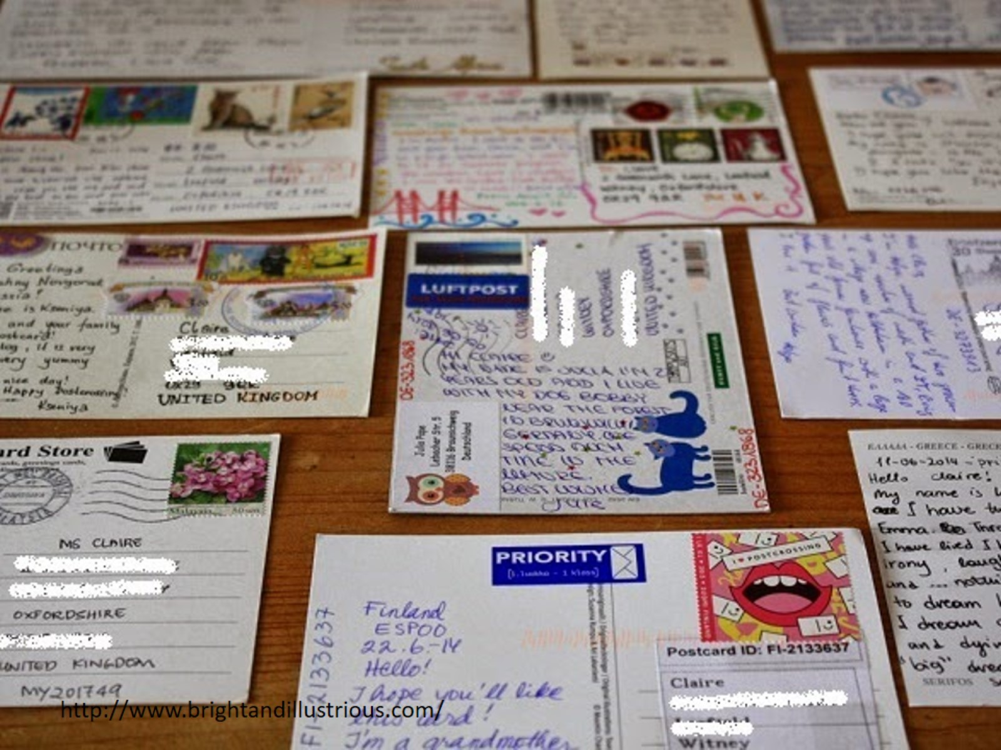

Slide 45
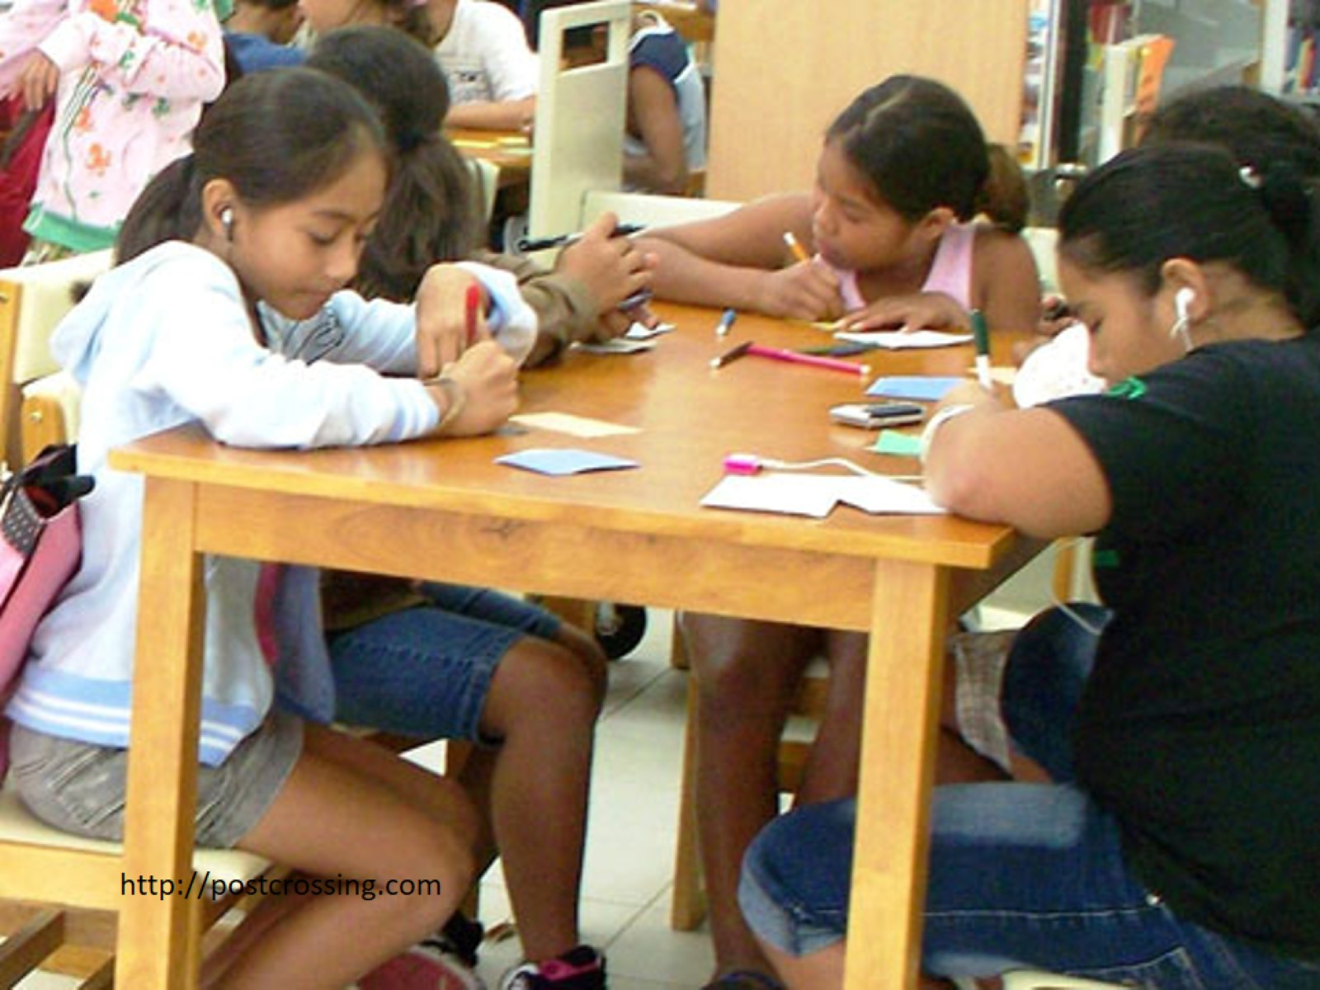

Slide 47
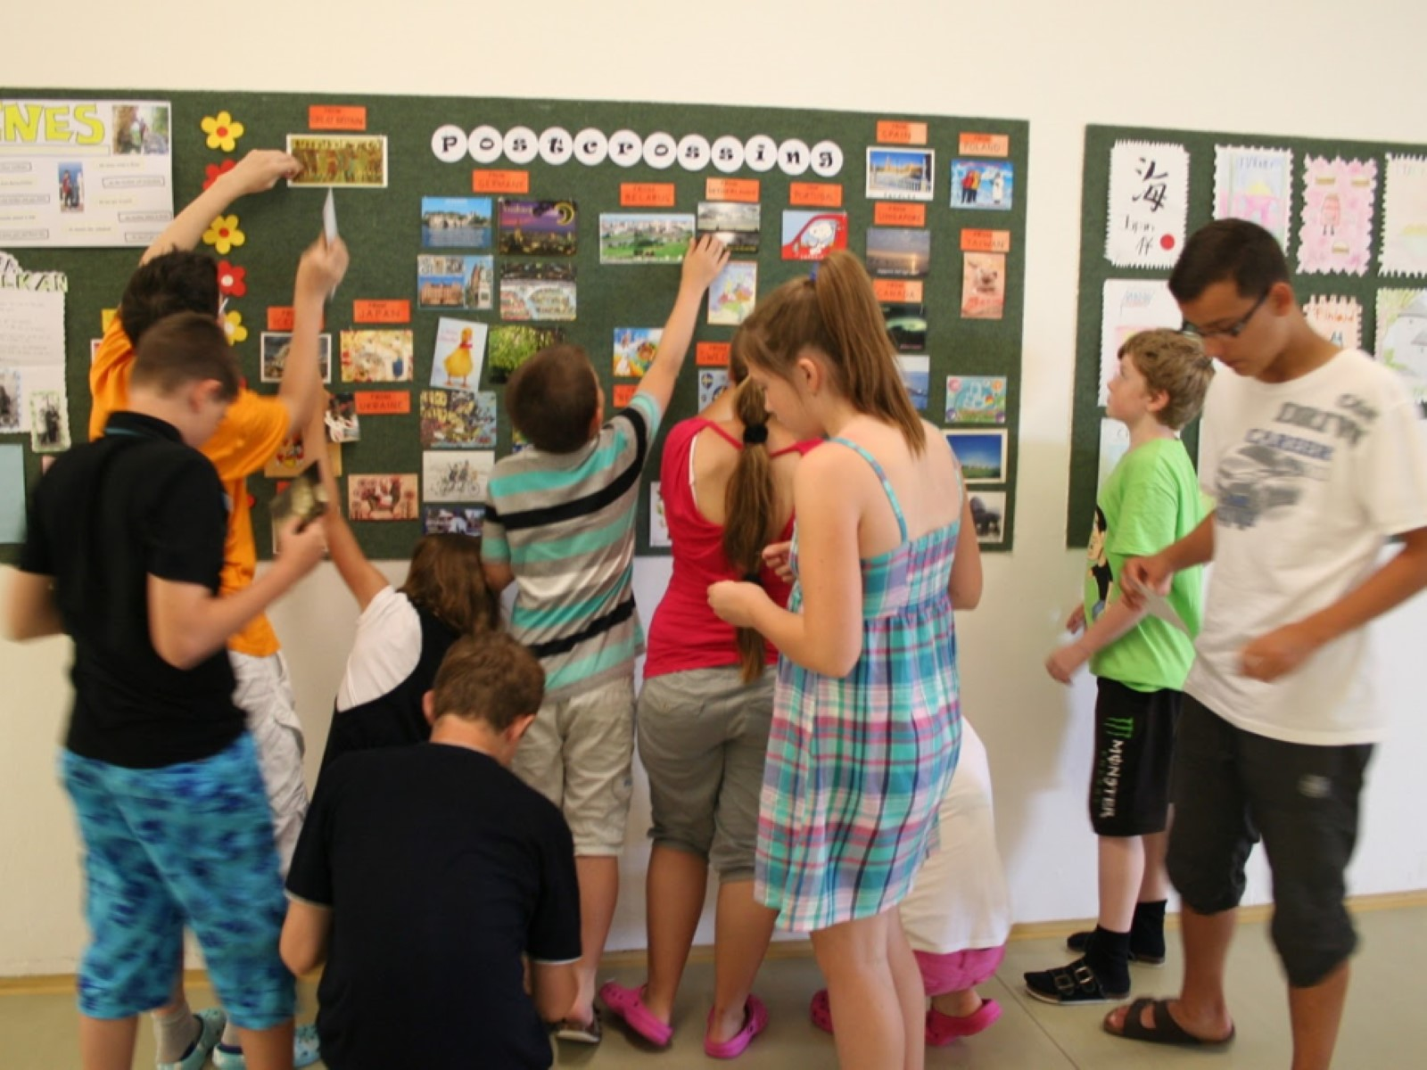

Slide 48
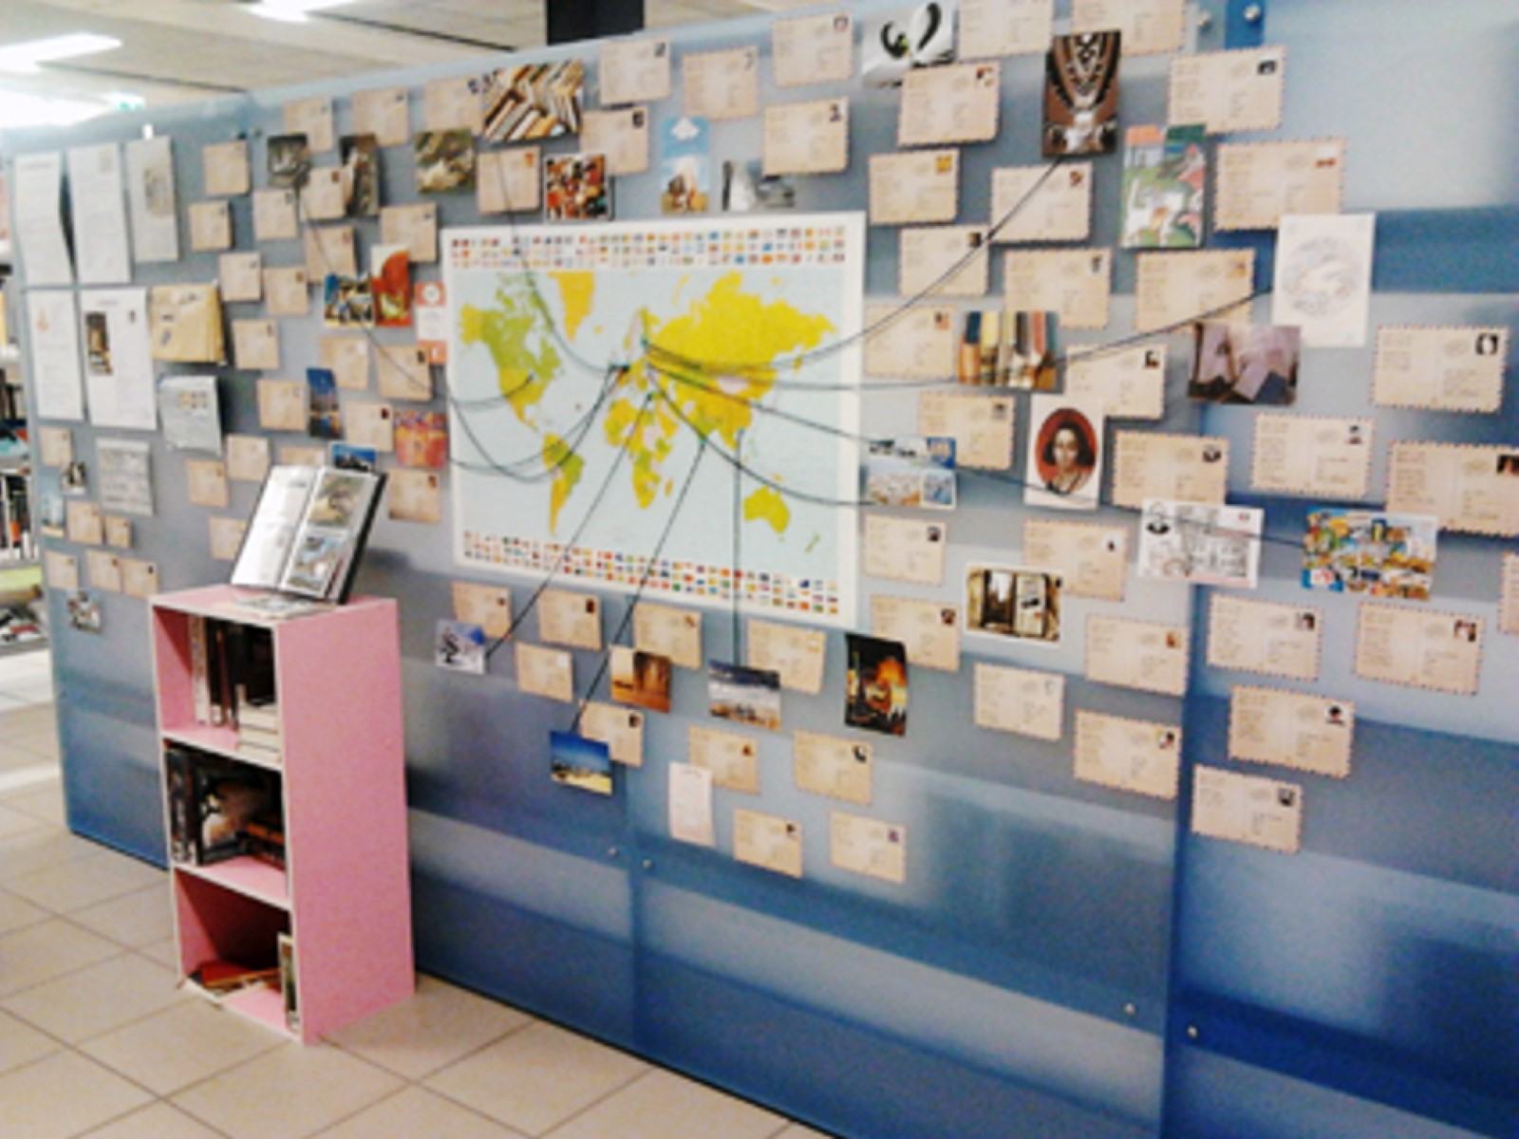

Slide 49
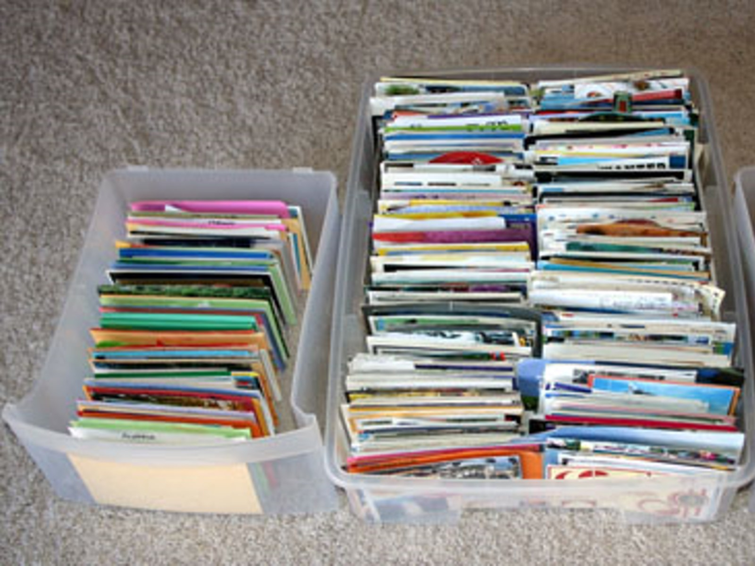

Slide 51
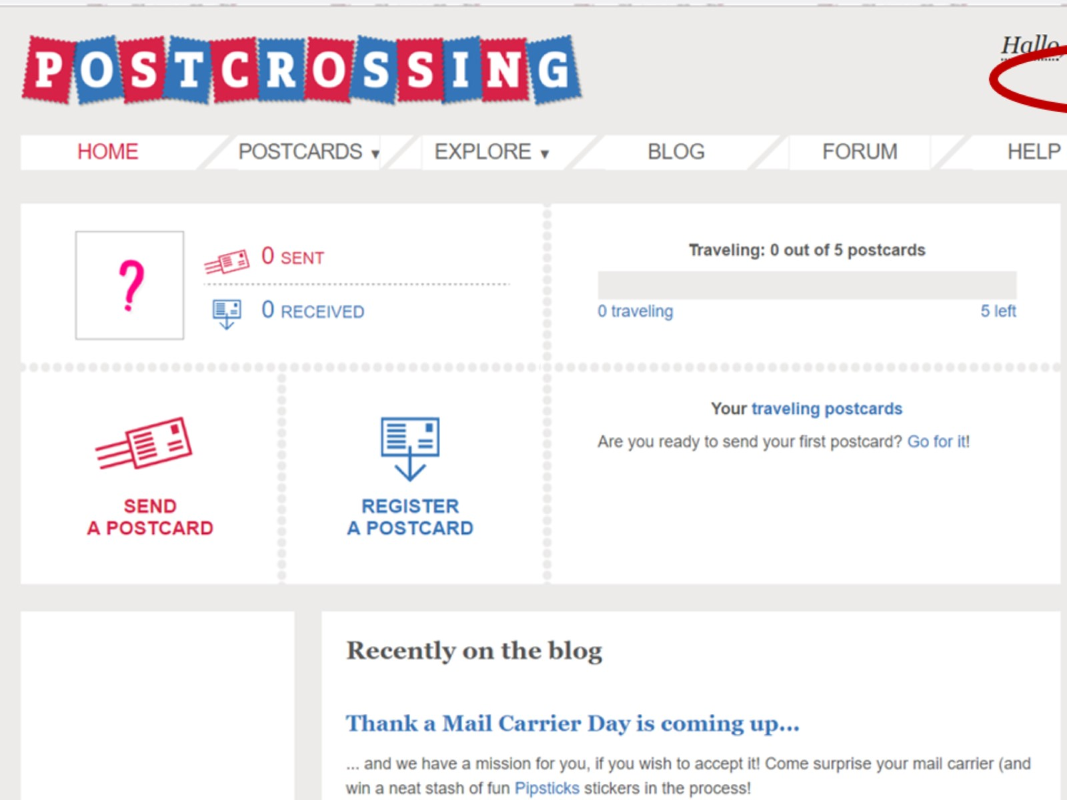

Slide 52
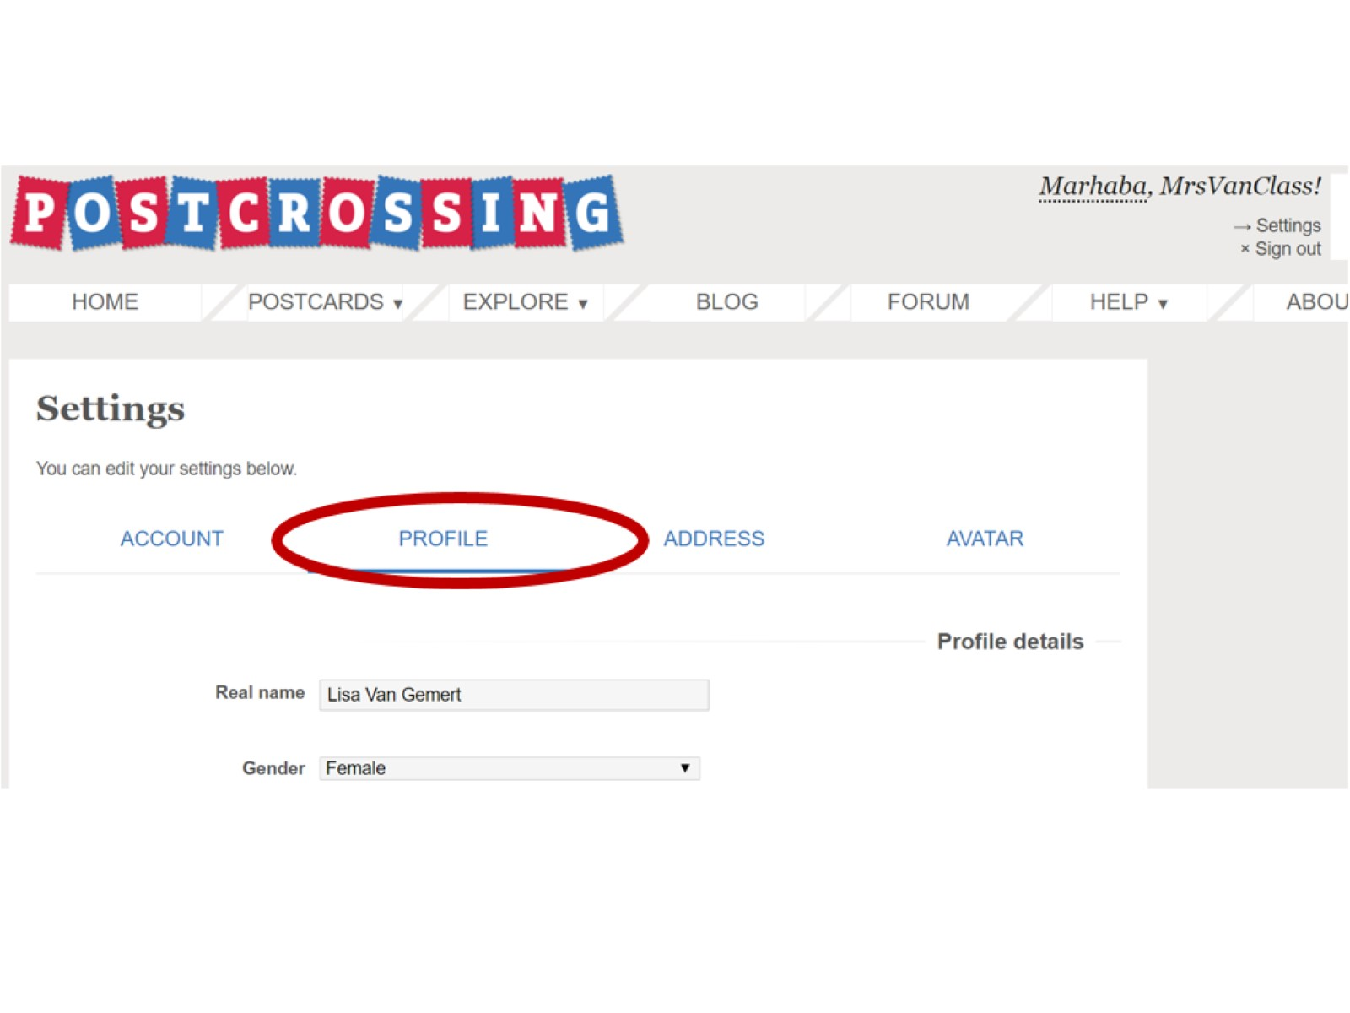

Slide 53
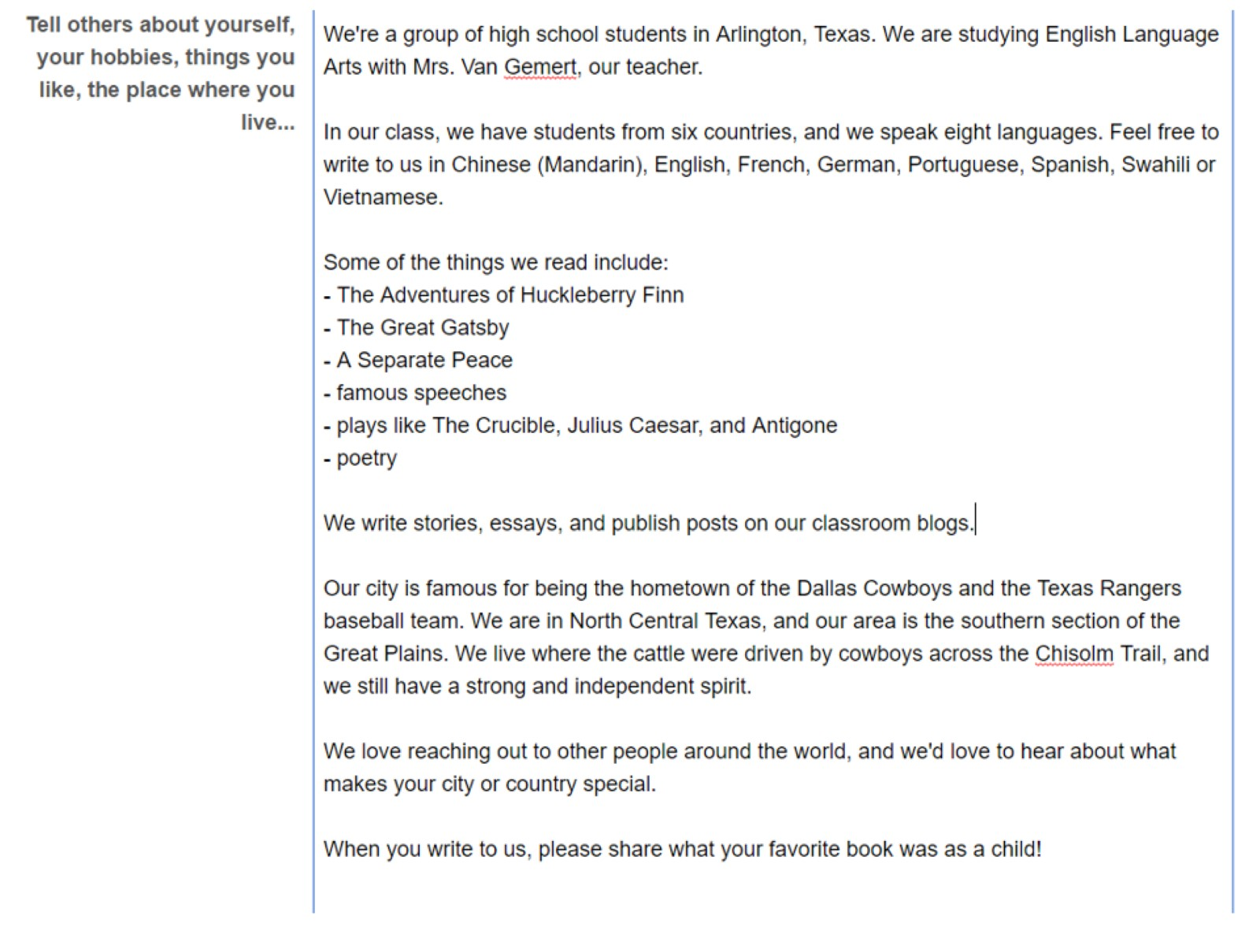

Slide 54
Ideas:

Slide 56
peacecorps.gov/educators

Slide 58
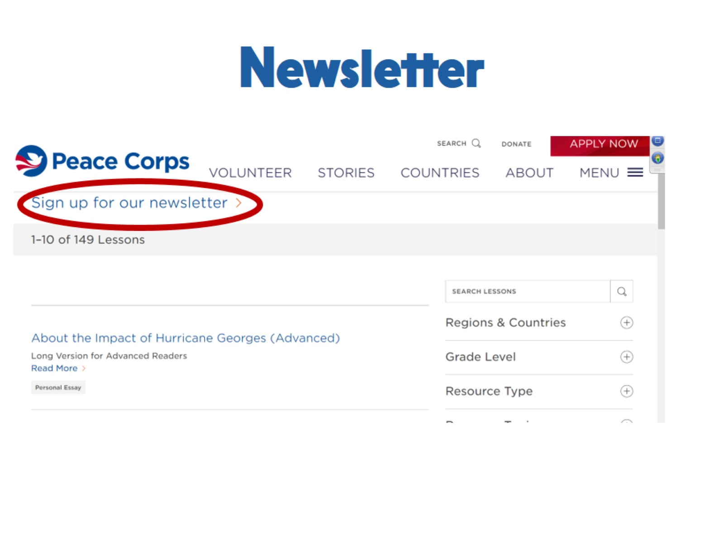
Newsletter

Slide 59
Correspondence Match

Slide 60
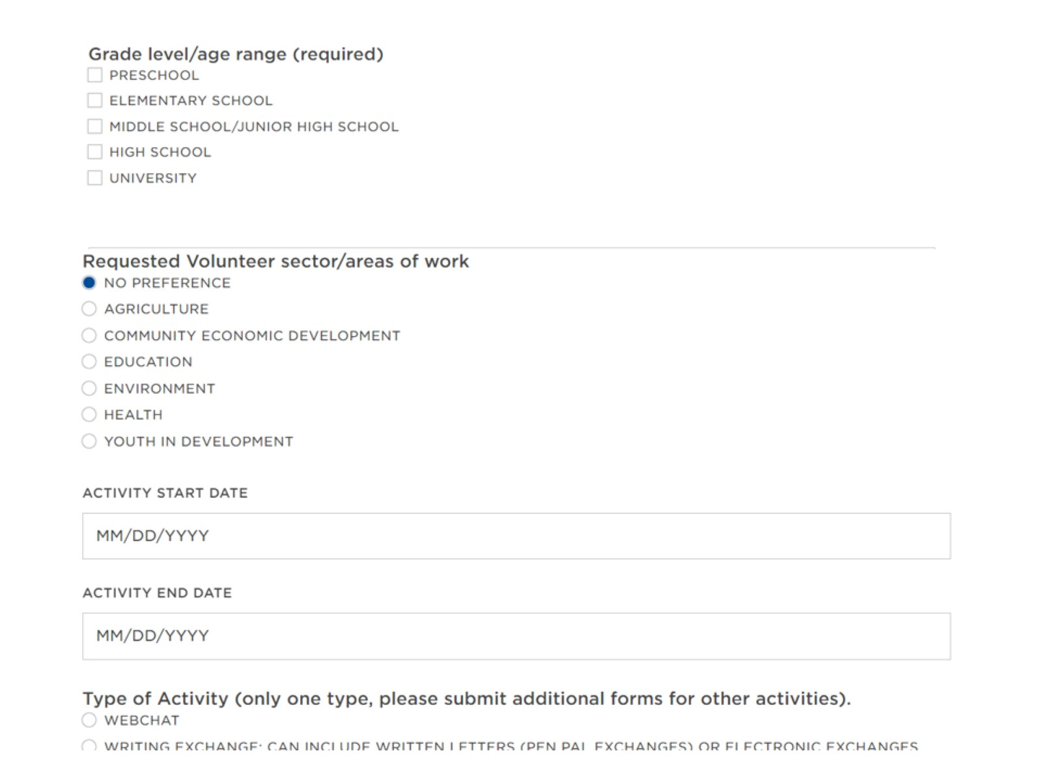

Slide 61
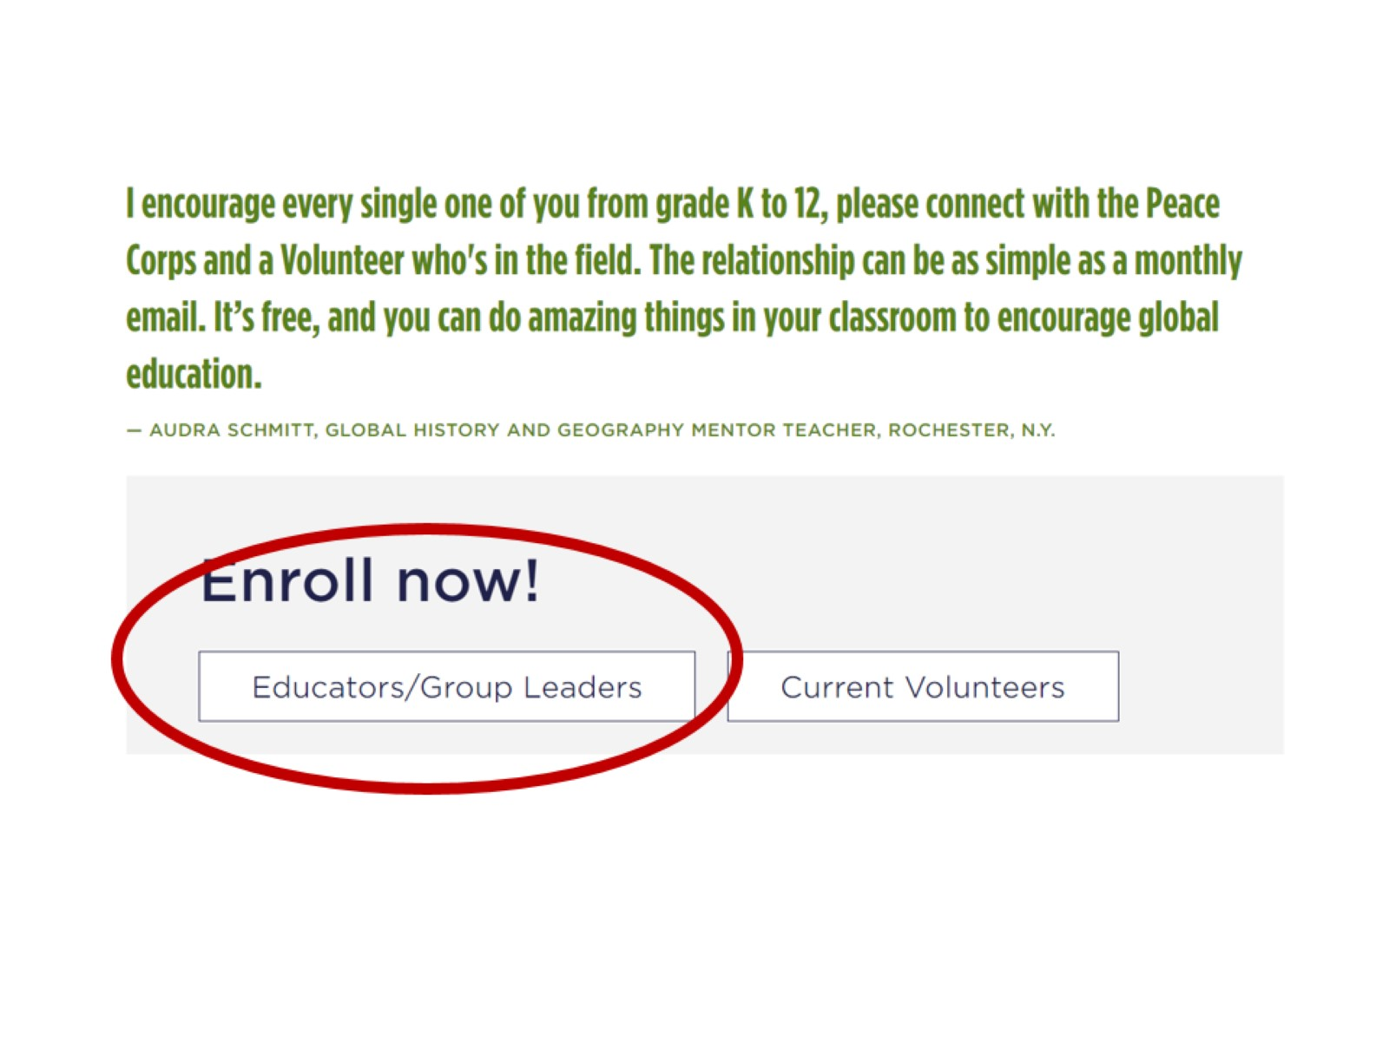

Slide 62
Speakers Match

